Slide 1
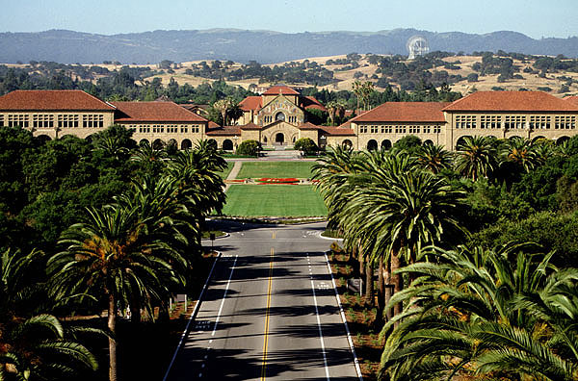
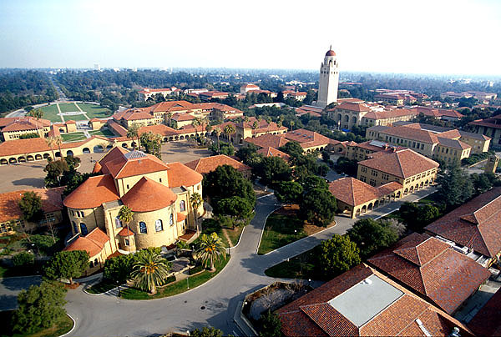
Gravity, Relativity, GP-B and GPS
---
“One thing leads to another.”
ひとつの発想からさらなる展開へ
---
Tom Langenstein - November, 2015
Notes:
“ko-n-ni-chi-wa” – hello
Thanks, Yusuke, for the opportunity to speak to your group today.
My talk today is going to be a STORY about:
“Gravity, Relativity, GP-B and GPS”
…and, as one of my colleagues used to say:
“One thing leads to another “
““hi to tsu no hassou ka ra, sa ra na ru ten kai e”
These are some pictures of the campus of Stanford University. Stanford is located in CA on the San Francisco peninsula half way between San Francisco and San Jose. Stanford right in the heart of Silicon Valley.
Stanford is much smaller than Tokyo University. Stanford has about 7,000 undergrads and 7,000 graduate students. It is known primarily as an engineering school. The most popular Majors include … Entrepreneaurs, etc.

Slide 2
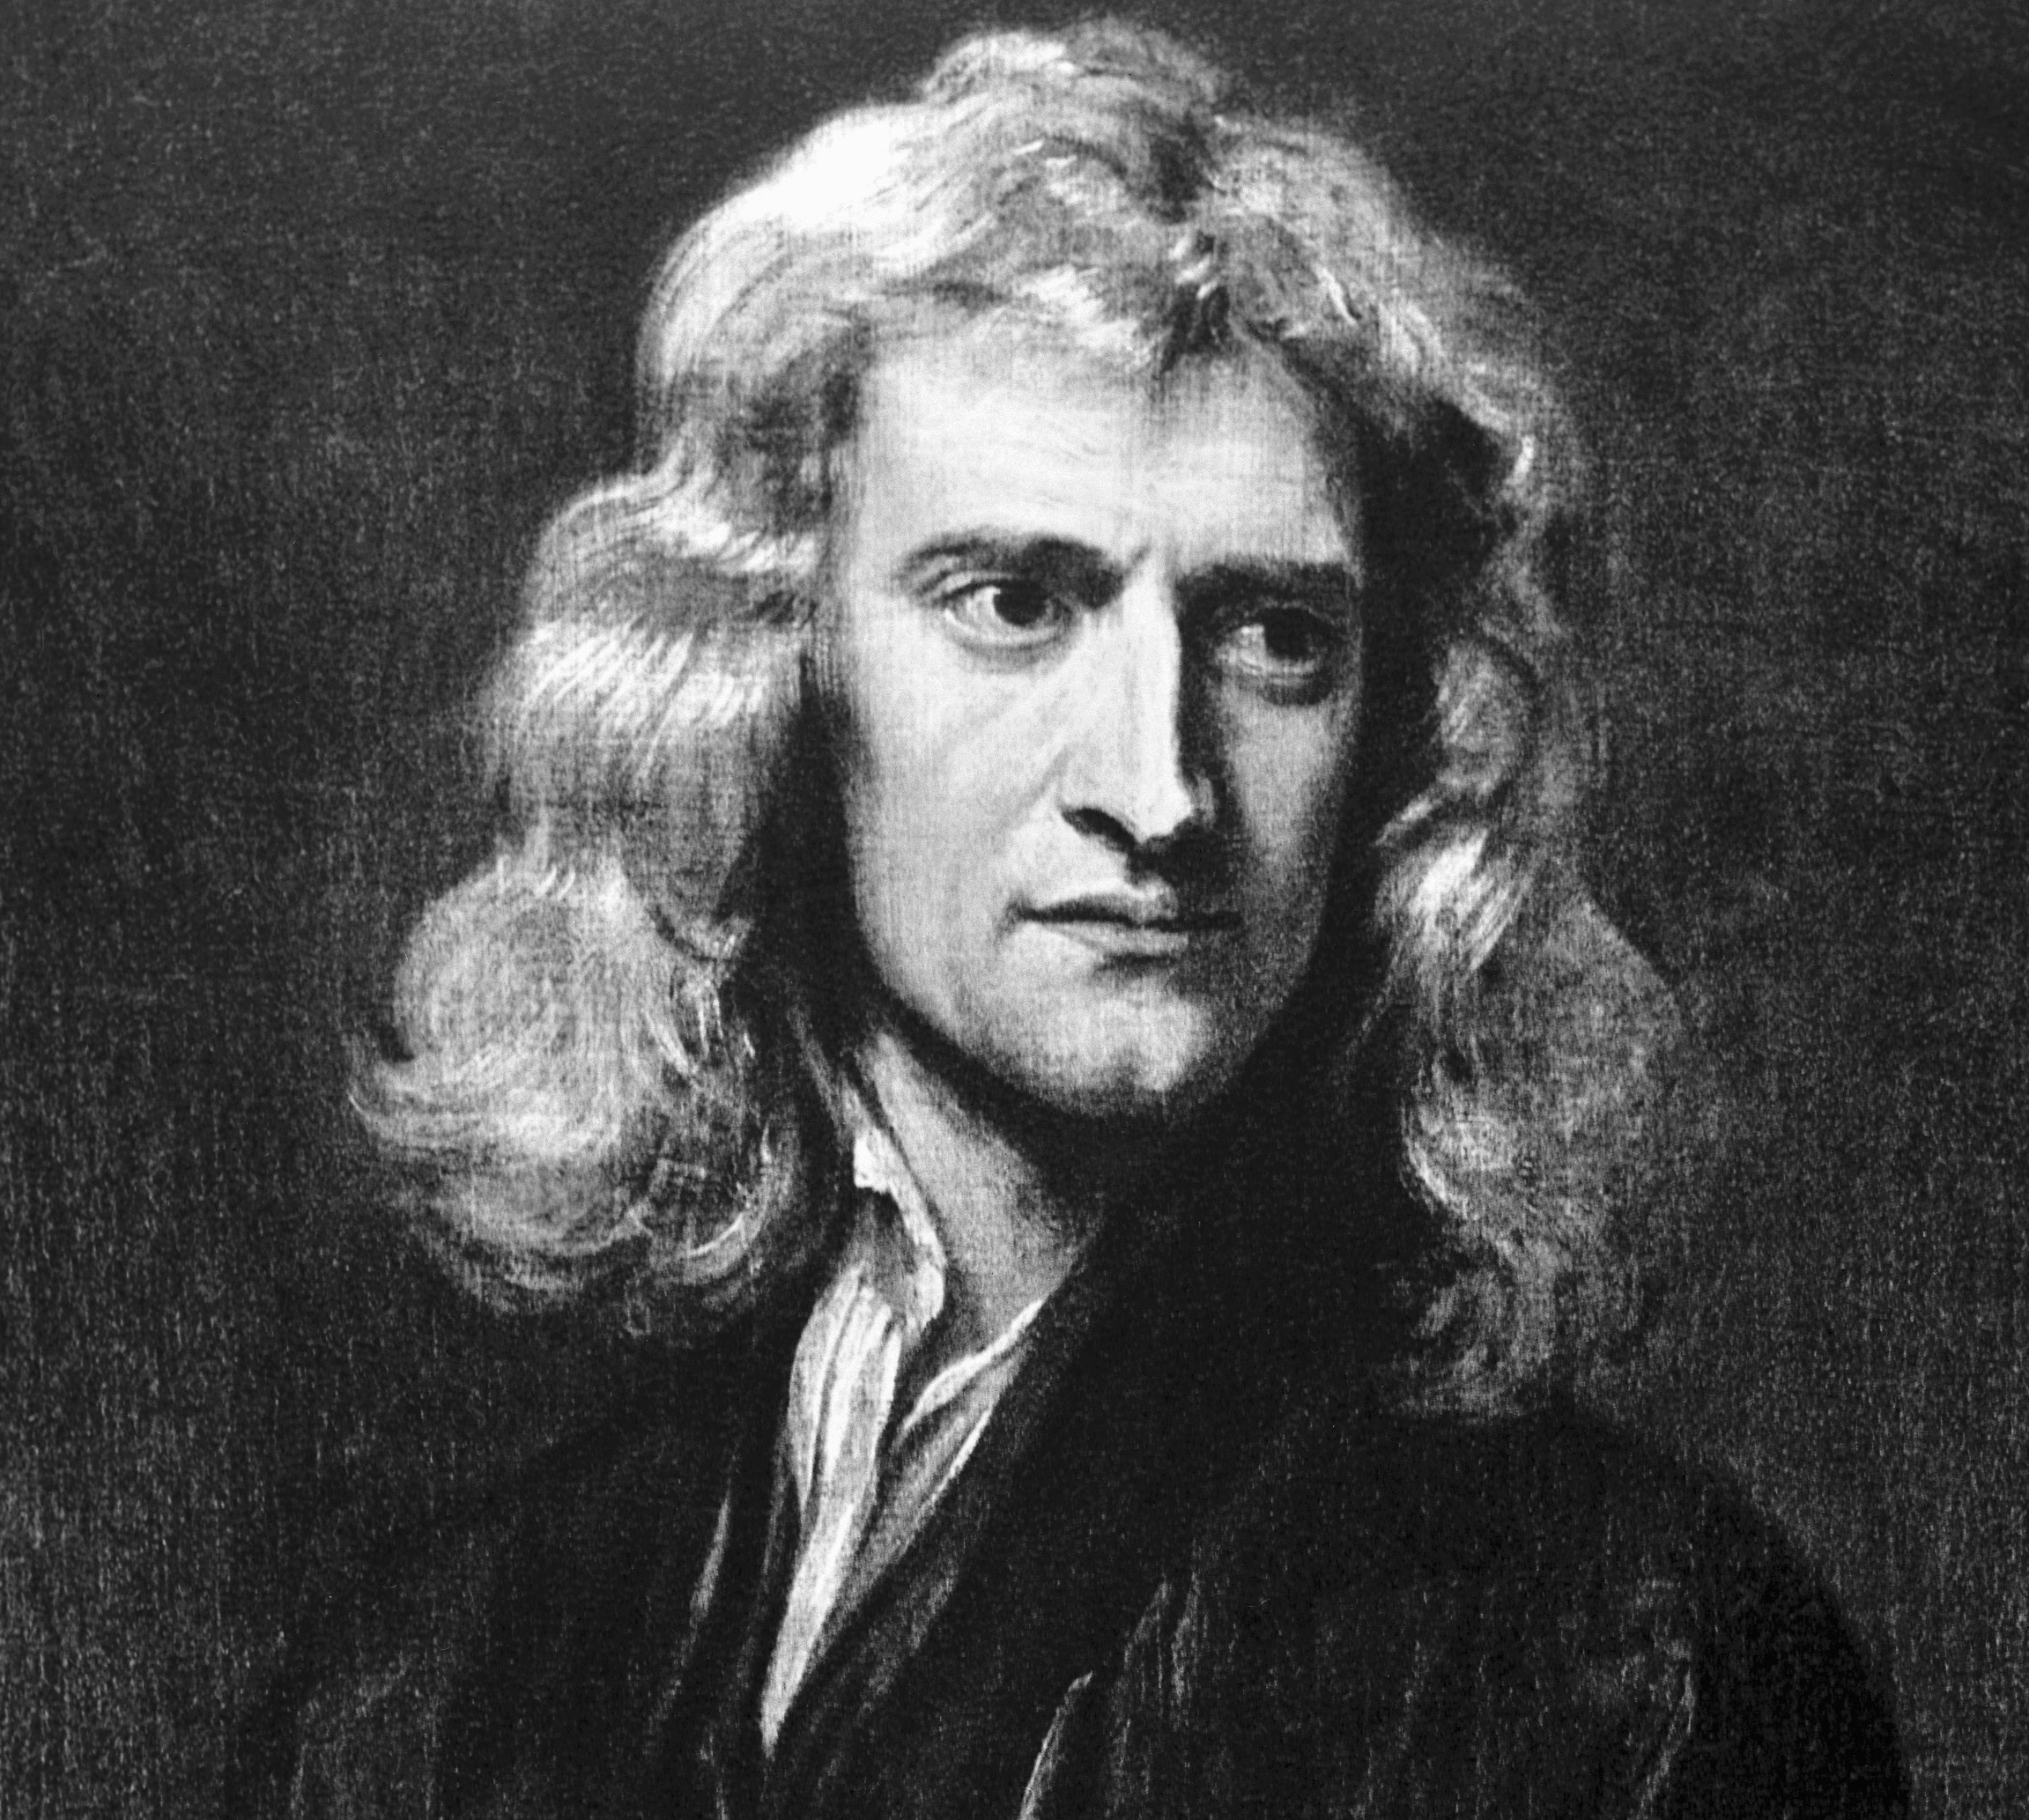
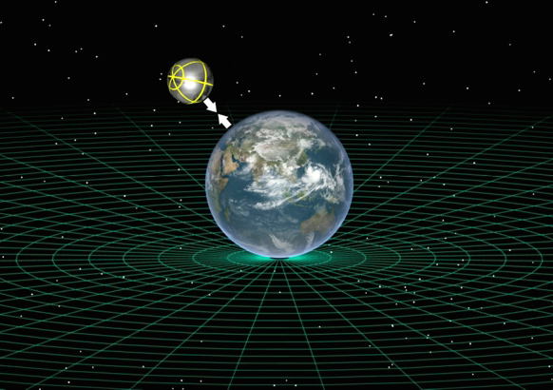
Gravity
A Force or a Field?
Newton – 1687 – … a Force
Bodies attract each other directly at a distance
Gravity acts instantaneously on an object
F = G (m1 * m2) / r²
Notes:
Ok …Let’s go back some 329 years and start with Gravity.
In 1687, Isaac Newton defined Gravity as a FORCE,
It was a FORCE in which bodies attract each other directly at a distance and proportional to their mass.
Gravity, as Newton defined it, would act INSTANANEOUSLY on an object.
This is Newton’s equation.

Slide 3
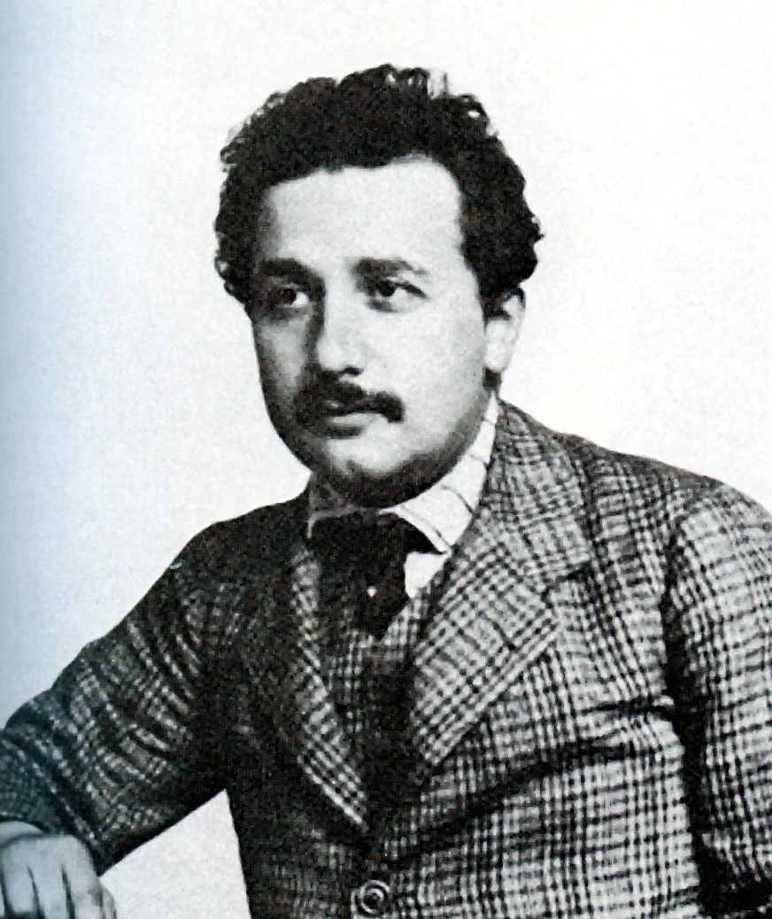

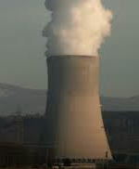
Gravity
A Force or a Field?
Einstein – 1905
E = mc²
Special Theory of Relativity
One small problem
Speed of light was a constant
Notes:
Moving on some 200 years
in 1905, Albert Einstein published what was to be called the Special Theory of Relativity.
Probably the most famous equation of all time E=mc²
However, he recognized that there was one small problem with his theory … It disagreed with Newton.
Einstein believed the speed of light was a CONSTANT and was the MAXIMUM speed which matter can travel in space.

Slide 4
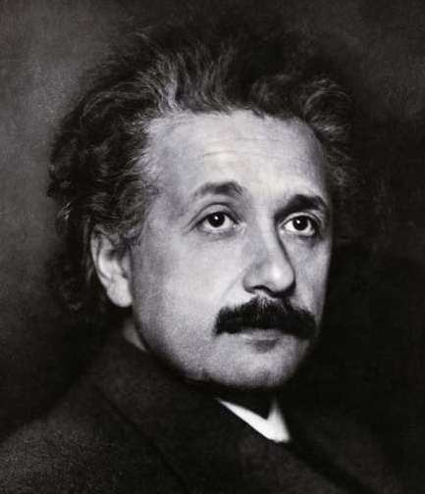
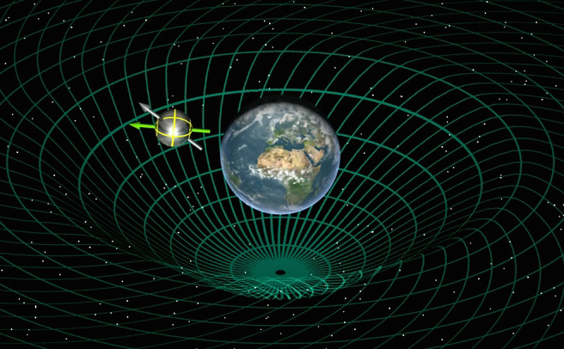
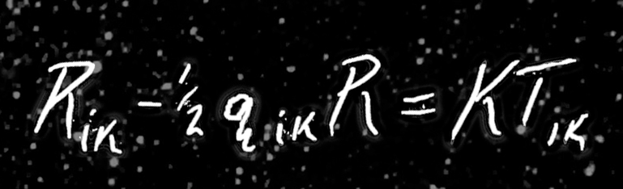
Gravity
A Force or a Field?
1915 Einstein …a Field
Gravity is a property of space and time … or ‘spacetime’
Solved speed-of-light inconsistency with Newton
Theory of General Relativity
Notes:
He pondered this problem or inconsistency for about 10 years.
In 1915 he came up came with his own concept of Gravity, namely that Gravity wasn’t a FORCE as Newton defined it. It was a FIELD.
…and that Gravity was a property of space AND time or as the concept came to be called ‘SPACETIME’
This solved his speed-of-light problem with Newton.
…and has come to be called the Theory of General Relativity.
You can see his equation here … it can be written different ways.

Slide 5
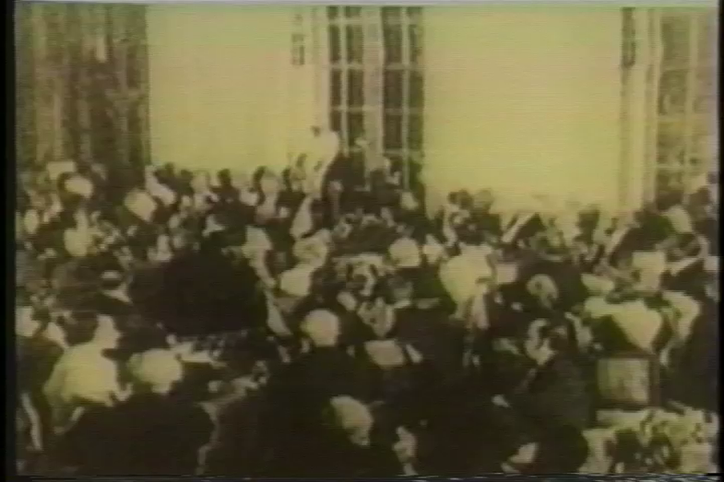
George Bernard Shaw – “Makers of Universe” Speech
Notes:
Here’s an old video clip from 1930 in a speech George Bernard Shaw gave to the Fabian Society.
George Bernard Shaw was a friend of Einstein and a famous Playright, Comedian and Political Activist.
It’s called the “Makers of Universe” speech.
Its an old clip, but I think you’ll enjoy it.

Slide 6
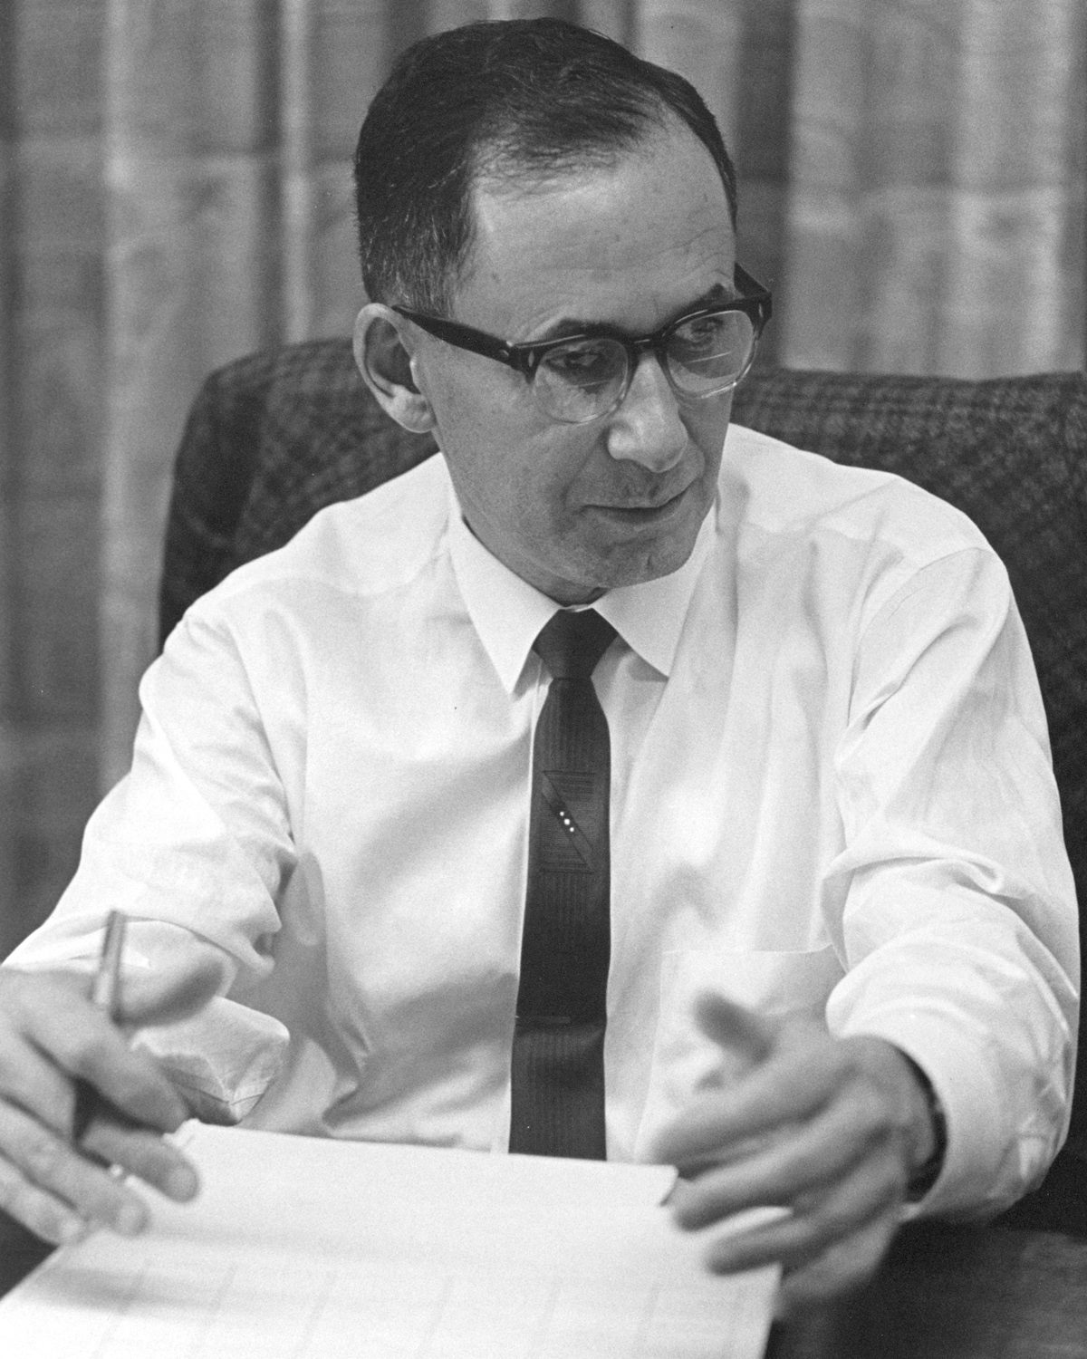
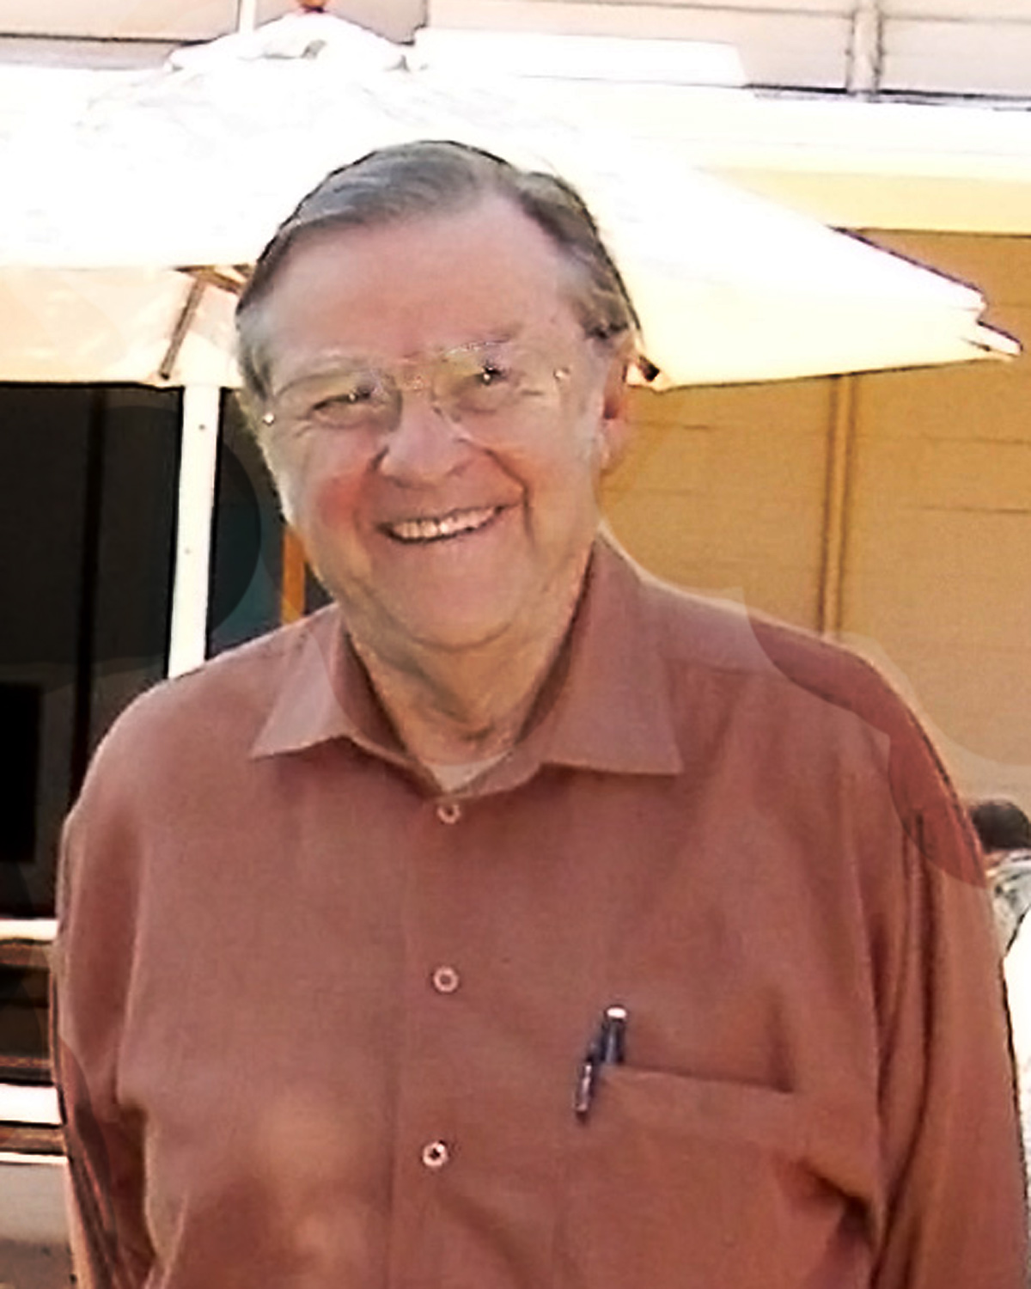
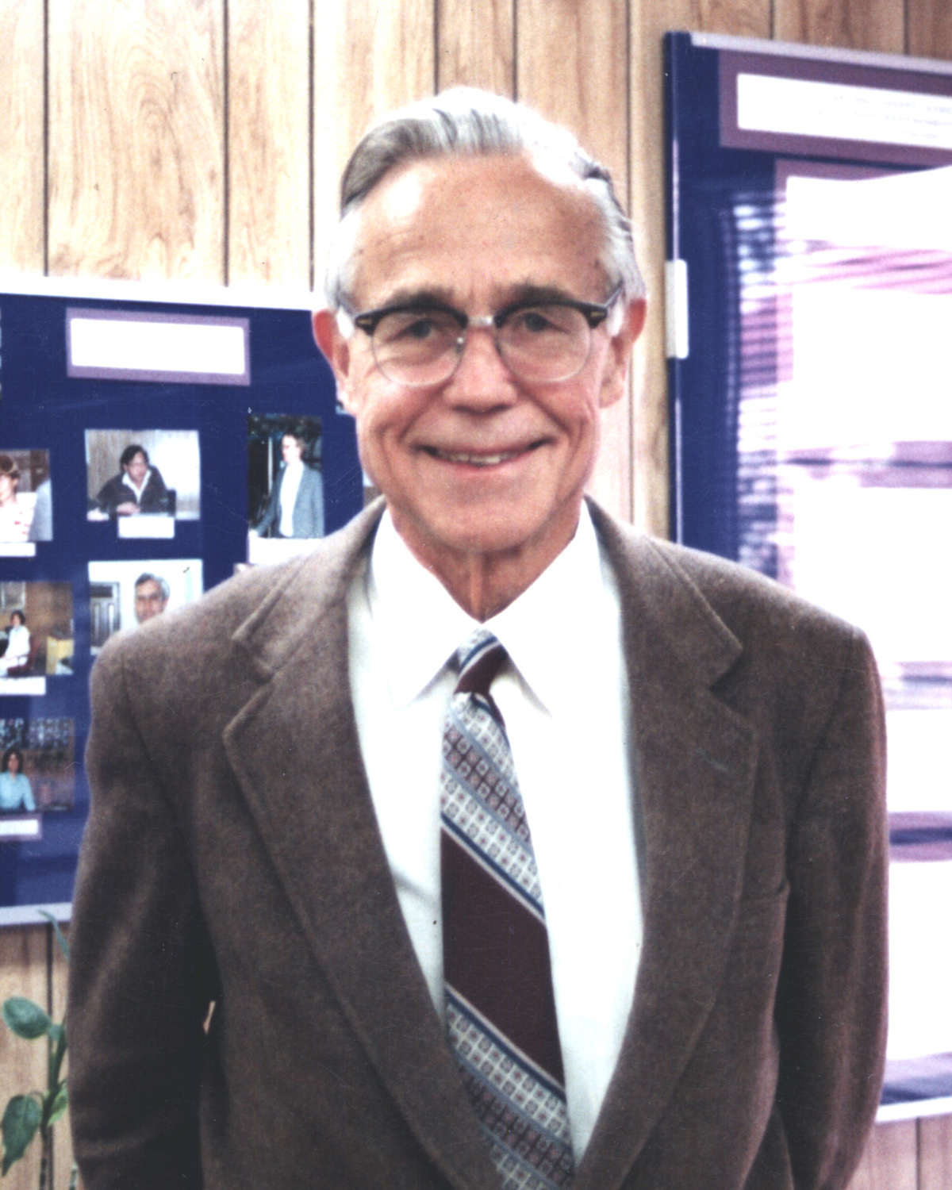
Gravity Probe B Experiment
(or GP-B)
1960 --- Conceived by three Stanford Professors
While sitting around a swimming pool
Schiff
Cannon
Fairbank
Notes:
One problem with the Theory of General Relativity is that it’s very, very difficult to measure.
Again “one thing leads to another”.
Jumping ahead some 50 years, in 1960.
So the story goes, three professors were sitting around the Stanford swimming pool …kind of like an Onsen
They were doing what Professors do --- and came up with a physics experiment that should be able to measure Relativity.
The experiment came to be called Gravity Probe B or GP-B.

Slide 7
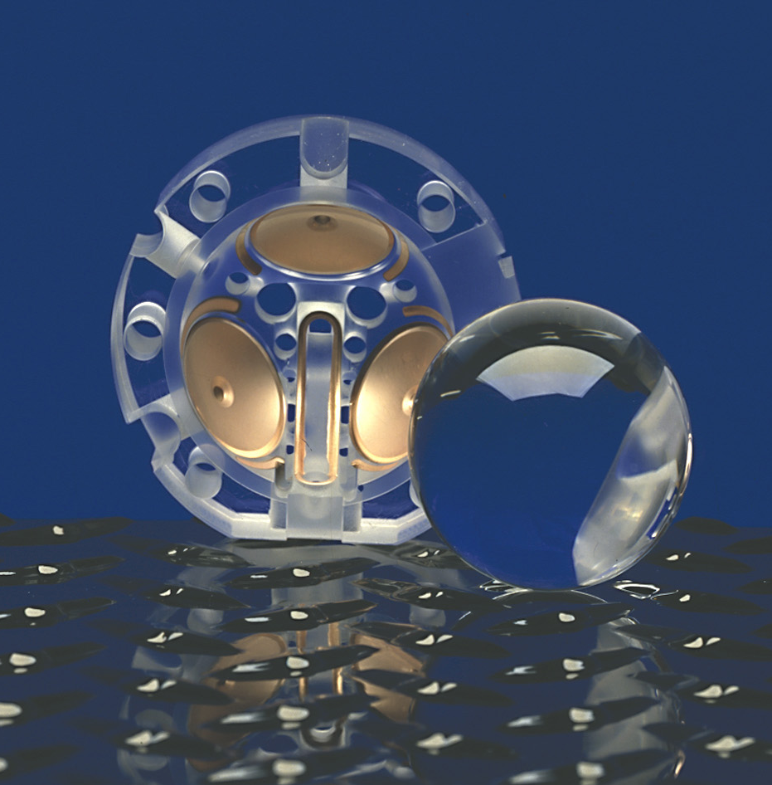
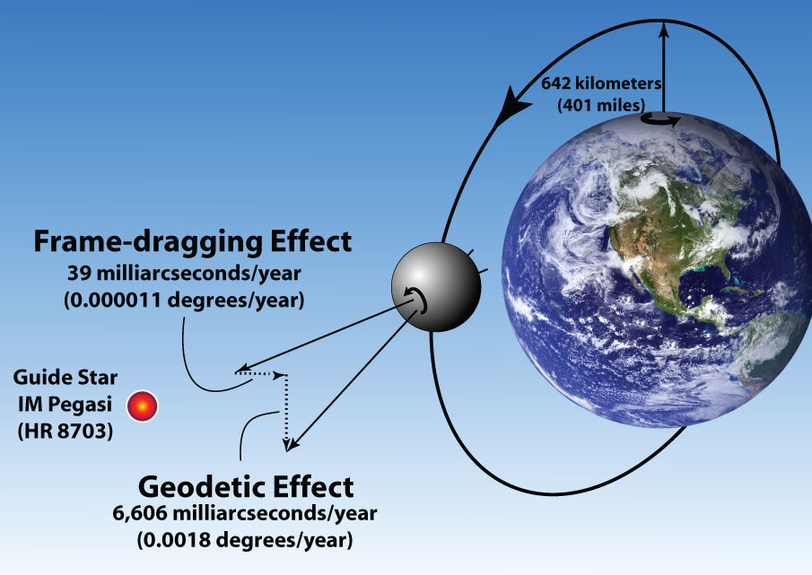
Gravity Probe B - Simple Concept
A near-perfect gyroscope, shielded from torques,
will experience two effects of General Relativity
Notes:
Gravity Probe B was basically a simple concept.
You build a NEAR-PERFECT gyroscope …and create an extremely pristine environment for it to operate in (thermally, electrically, vacuum, etc). Then you launch it into orbit and point it at a distant star.
According to Einstein’s equations, the gyroscope should experience two effects of General Relativity by SLIGHTLY precessing on its axis of spin over time.
By SLIGHTLY, I mean very, very slightly. Here’s the two effects… Geodetic Effect is the larger 6,600 milliarcsec … cause by the mass of the earth
The smaller one “Frame-dragging” is result of the earth’s rotation on its axis, which causes ‘spacetime’ to spin around itself.
The ‘Frame-dragging’ effect had never been measured before and some people thought Einstein’s equations could POSSIBILY break-down and be invalidated if GP-B came up with different results.
The frame-dragging effect on our gyroscopes would only be ~39 millarcsecs/year.
Our goal was to create a gyroscope experiment accurate to 0.1 milliarcsecs / year

Slide 8
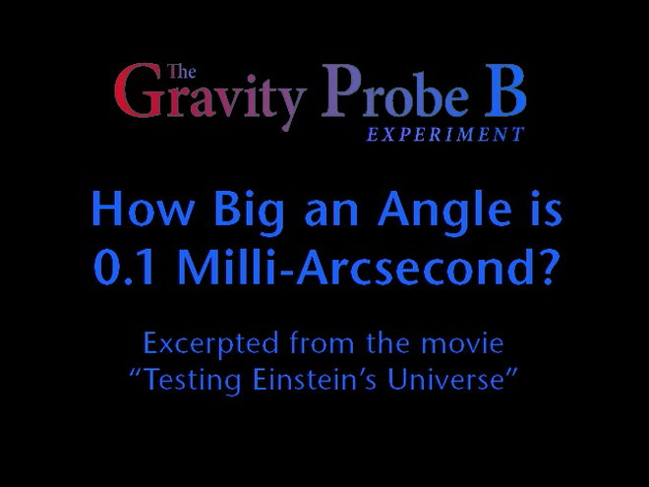
Notes:
So …“How Big an Angle is 0.1 of a Milli-Arcsecond.”
Here’s an excerpt from a video we created.

Slide 9
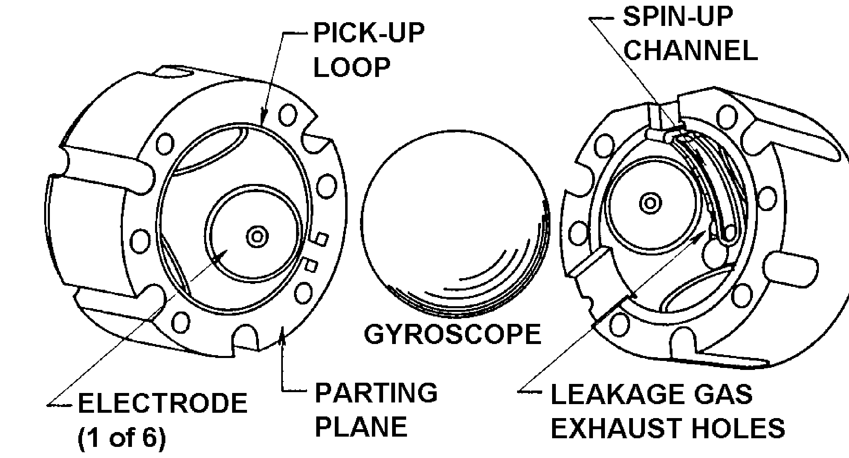
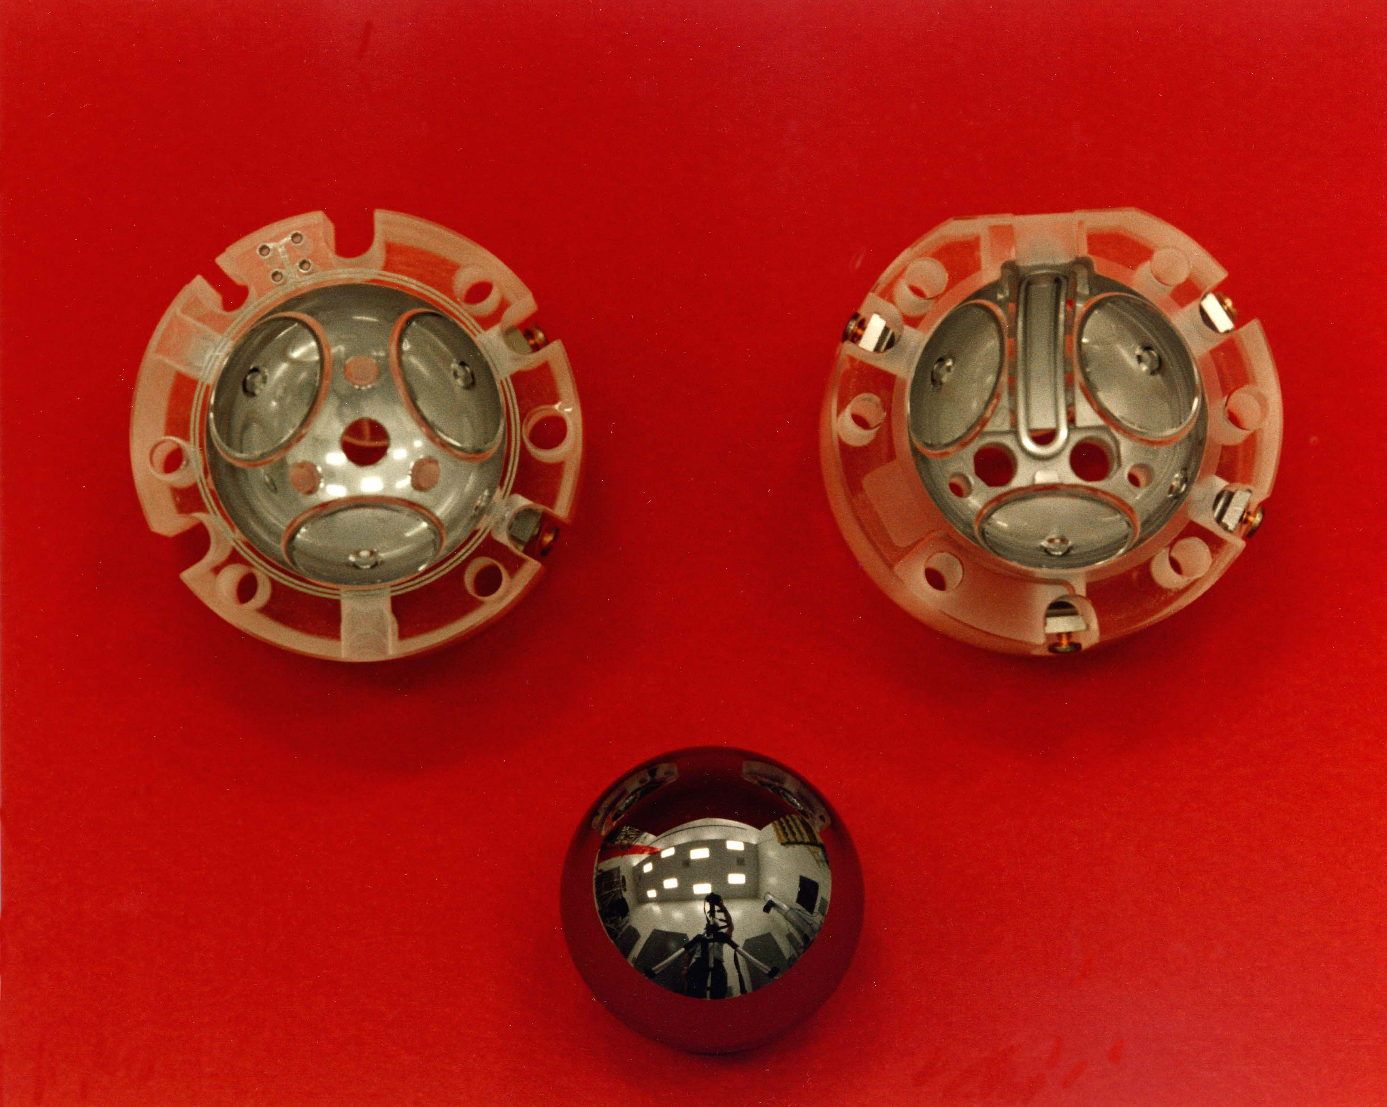
The GP-B ‘Near-Perfect’ Gyroscope
Almost perfect spheres
-
Electrical Suspension
-
Gas Spin-up
-
Magnetic Readout
-
Cryogenic Operation
^{1 marcsec/yr}
"Everything should be made as simple as possible, but not simpler."
-- A. Einstein
Notes:
What did GP-B’s gyroscopes look like? Here’s a photo of the gyroscope that we flew.
The gyro, the housing and the entire instrument were made from the purest fused quartz available. This eliminated any issues with differential contraction or expansion of dissimilar materials.
The sphere or rotor (as we called it), was machined over a sequence of steps to have a sphericity that pushed the boundaries of metrology. If you can imagine ….
We used photolithography techniques to lay down a niobium coating which was both magnetic and superconducting at cryogenic temperatures.
When you spun the rotor, the magnetic and superconducting properties of the niobium coating created something called a ‘London Moment’ magnetic field that exactly aligned with the spin up axis. This allowed us to remotely read-out what the rotor was doing without disturbing it.
You can see on this chart that the two realivistic effects we were trying to measure were several orders of magnitude more precise than the best ESG’s or Laser Gyros on earth.

Slide 10
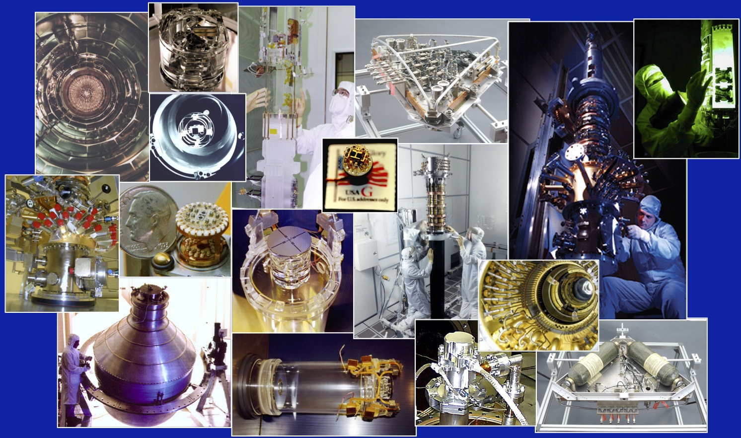
Gravity Probe B – Simple Concept
But lots of complicated facilities & hardware to develop & test
Notes:
Again, the GP-B Experiment was a simple concept.
However, there were a HUGE number of other technical issues and challenges to solve along the way.
Here’s some photos of a few of the items we built.
As you can imagine, each one has it’s own unique story.

Slide 11
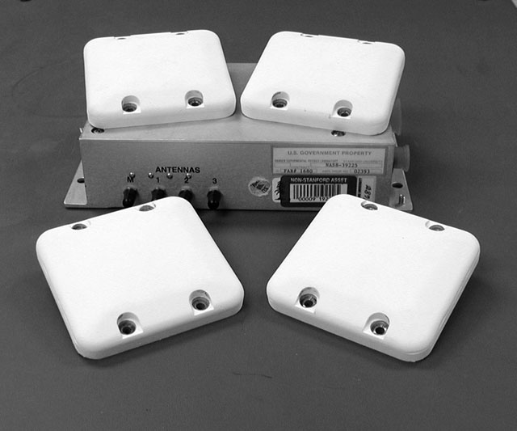
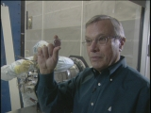
Gravity Probe B – GPS System
Some difficult orbit requirements
Late 1980’s
Brad Parkinson
Trimble GPS Receiver & Antennas
0000 | Position Accuracy | Velocity Accuracy
Requirement | 25 m RMS | 7.5 cm/sec RMS
Actual | 2.5 m RMS | 2.2 mm/sec RMS
Notes:
Along the way, one of the technical challenges we had to solve was how to get into a very precise orbit …stay in that orbit …and to be able to accurately measure it.
Luckily we had someone who knew a lot about that subject and how to solve it. Brad Parkinson was the Stanford Program Manager at that time.
Prior to becoming a Stanford Professor, Brad was a Col. In the Air Force and he is credited with creating the Global Positioning System (or GPS)
With Brad’s lead, we were able to take a high-precision Trimble GPS receiver and convert it for space use.

Slide 12
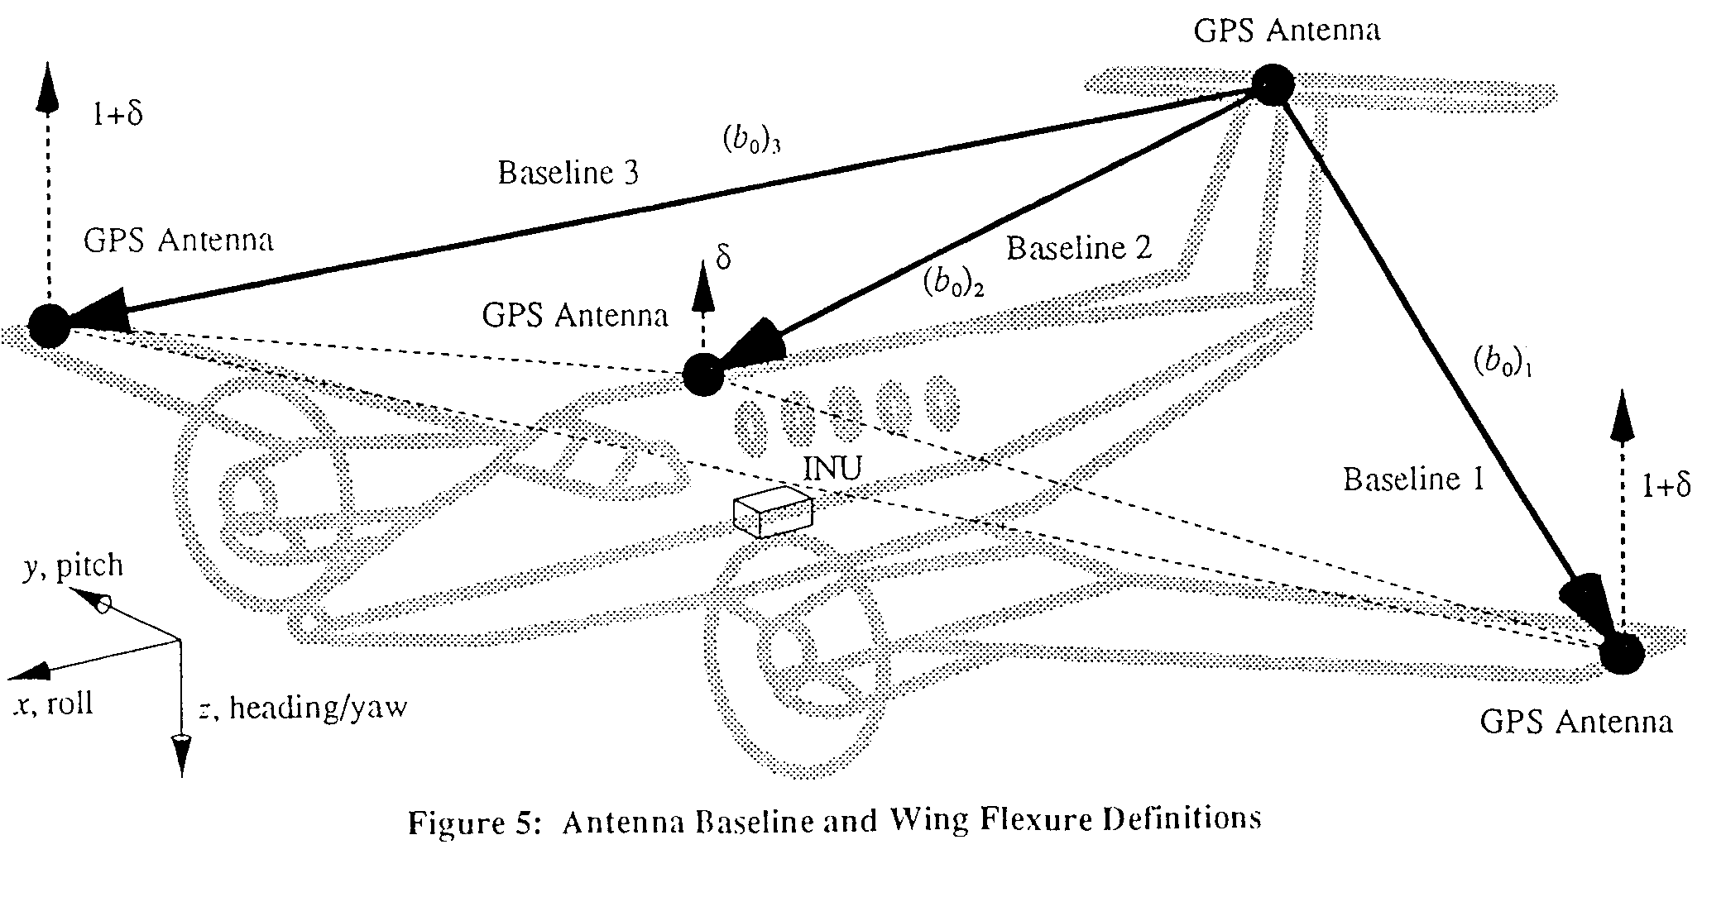
Gravity Probe B - GPS Solution
Leads to other GPS-related research
Early 1990’s – very fertile period
“One thing leads to another …”
  Students began flight tests with GPS
Notes:
The early 1990’s became a very fertile period for GPS-related research for our team.
About that time the GPS Constellation was almost complete with 24 satellites.
And …”one thing began to lead to another” …some of our team members began experimenting with GPS using multiple antennas on a small Cessna airplane.
We found that we could not only navigate the plane but we also devised a system to automatically land the airplane at a local airport using an augmentation concept with psuedolites.

Slide 13
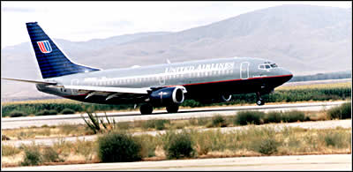
GPS Solution
Leads to other GPS-related Spin-offs
1st Spin off:
  110 Blind Landing Tests
  Local Area Augmentation System
  (LAAS) >>> GBAS
  FAA adopts satellite navigation
Typical Accuracy-
Four Inches
Notes:
About that time the FAA heard about what we were doing and became very interested in our NASA sponsored GP-B & GPS research.
They quickly arranged for a flight-test using a Boeing 737.
Using the 737, our grad student team was able to perform 110 blind landings in a row. You can see the typical accuracy that was achieved…
We had one anomally …
Very soon after that, the FAA announced that they were adopting satellite-based navigation.

Slide 14
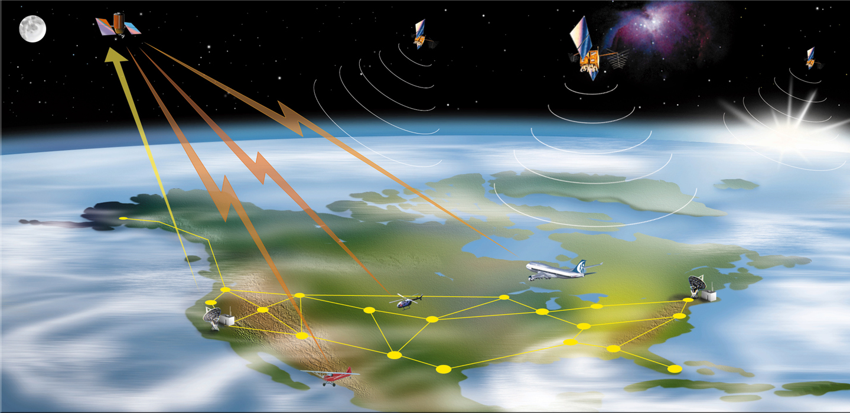
GPS Solution
Leads to other GPS-related Spin-offs
2nd Spin off:
  GPS positioning errors need monitoring
  Includes: clocks, ionosphere, troposphere, multipath, etc.
  Wide Area Augmentation System (WAAS) >>> SBAS
  Operational 2003
Notes:
Another significant GPS-related spin-off was the concept of monitoring GPS positioning errors using ground stations.
These errors include: the ionosphere, troposphere, clock errors, etc.
The concept came to be called the ‘Wide Area Augmentation System’ (or WAAS).
The FAA adopted this concept and after ~10 years of research and development the system was certified became operational in 2003.
… and has performed flawlessly since then.
Literally all commercials airplanes flying in the US these days have WAAS enabled GPS systems
… guaranteed real-time flying window of +/- 10 meters
… 6 second warning system

Slide 15
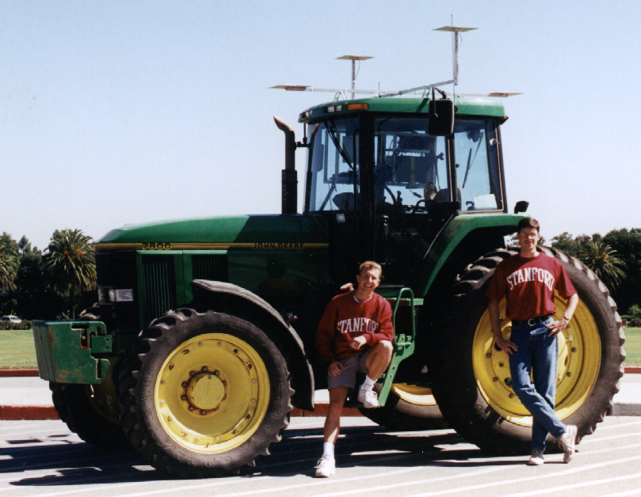
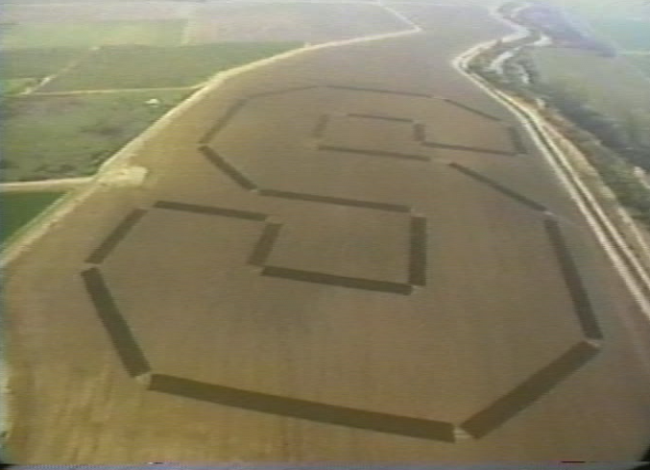
GPS Solution
Leads to other GPS-related Spin-offs
3rd Spin off:
  John Deere loans Stanford tractor
  1st demonstration of Precision Agriculture
  Multi-$B Industry and greatly improved crop efficiency
Notes:
The 3rd significant spin-off came in a very different field of technology.
John Deere, the tractor company, loaned us a tractor… and … Some of our students equipped it with a variety of GPS equipment.
Soon, our team was able to automatically remotely control the navigation of the tractor. This led to the first demonstration of precision agriculture using GPS.
You see the Stanford logo that was automatically plowed in a field near the campus…
Since then, Precision Agriculture has become a multi-billion $ a year industry and has greatly enhanced food production around the world.

Slide 16
GPS Solution
Leads to other GPS-related Spin-offs
  Lots of GPS-related research over the years
  ~ 75 advanced degrees awarded
  Stanford Center for Position, Navigation and Time – 2006
  Grant to build a GPS device to track sharks in the Indian Ocean
Notes:
Jumping ahead …
Stanford has performed a lot of GPS-related research over the years …primarily for the FAA.
Something like 75 advanced degrees have been awarded.
The Stanford Center for Position, Navigation and Time was created in 2006
…again: “One thing leads to another”
We were recently awarded a $500K grant to develop a GPS device tag, track and monitor sharks in the Indian Ocean.
We’re working with Barbara Block of Stanford Hopkins Marine on this effort.
You can see some previous efforts of tagging, tracking and monitoring tuna and other large fish and sharks.

Slide 17
GPS Solution
Leads to other GPS-related Spin-offs
Notes:
Jumping ahead …
We were recently awarded a $500K grant to develop a GPS device tag, track and monitor sharks in the Indian Ocean.
We’re working with Barbara Block of Stanford Hopkins Marine on this effort.
You can see some previous efforts of tagging, tracking and monitoring tuna and other large fish and sharks.

Slide 18
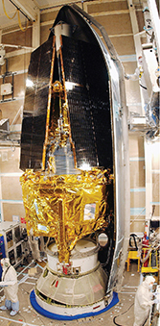
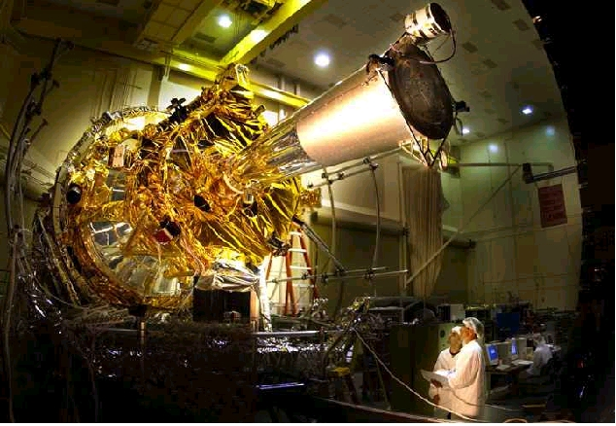
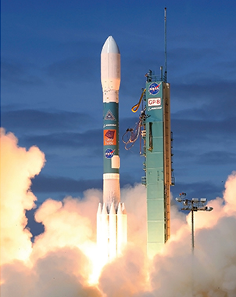
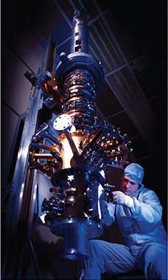
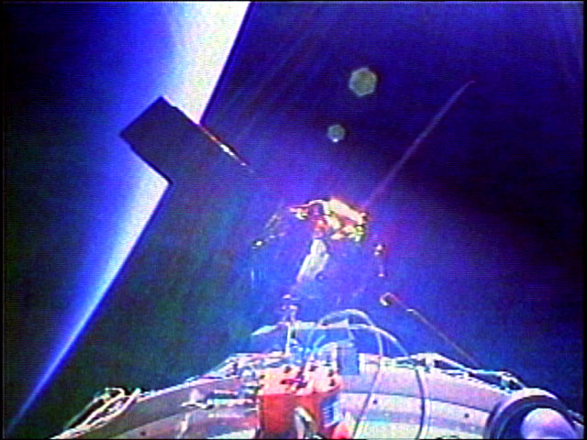
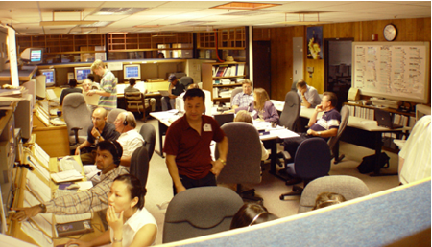
Gravity Probe B
Launched in 2004 – 44 years to Fly
Notes:
Going back to GP-B again.
It took 44 years from concept to reality.
The satellite was finally launched in 2004.
…and it operated very well on orbit for it’s 18-month lifespan.

Slide 19
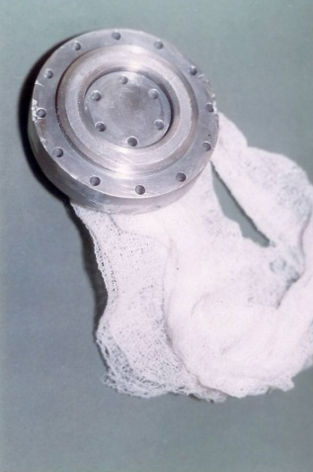
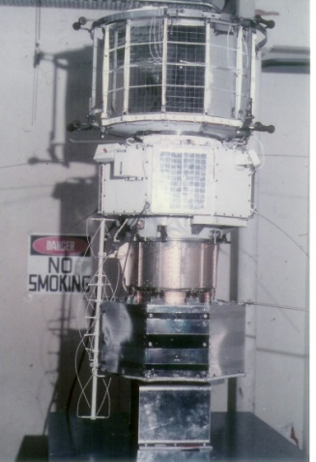
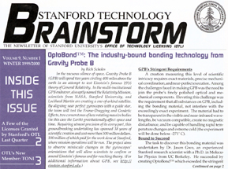
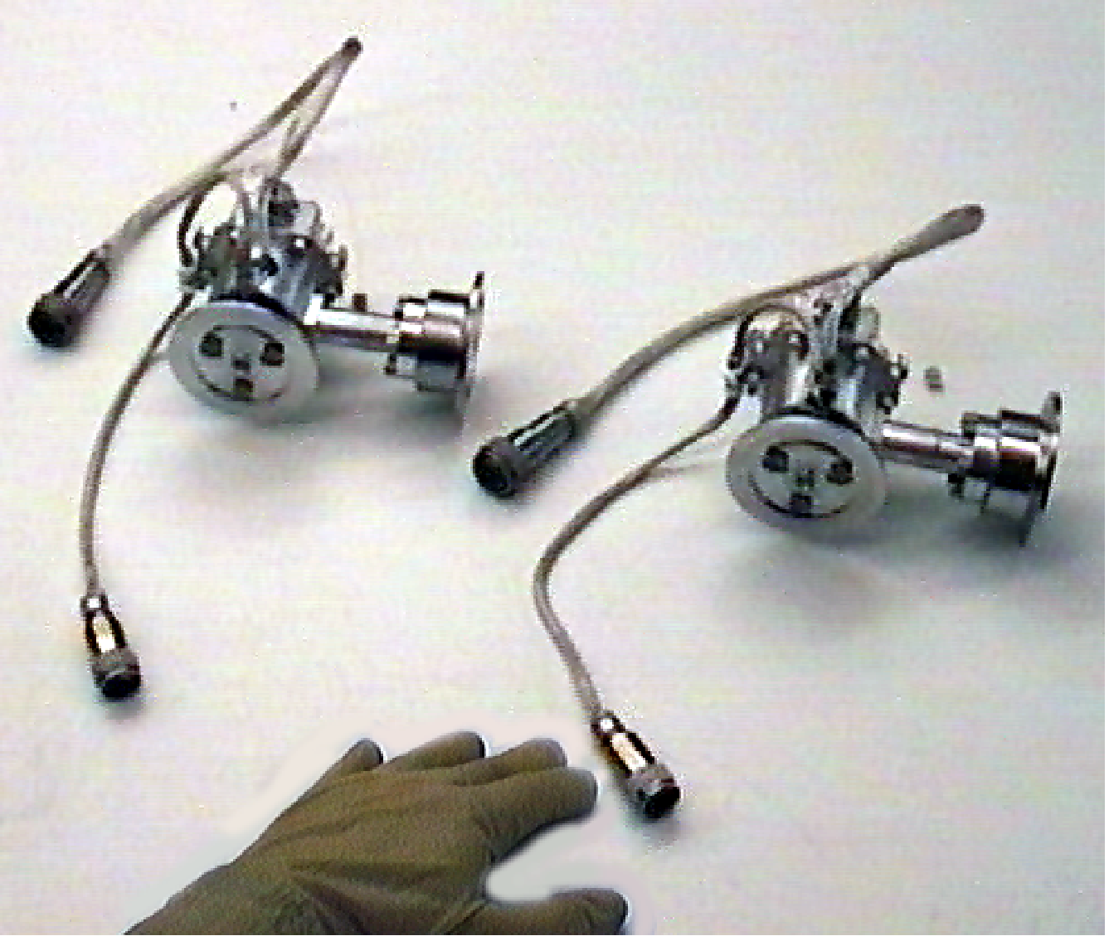
Students & the Development of GP-B
87 PhD’s --- (33 Physics; 52 Engineering (A/A, ME, EE); 1 Math, 1 Education)
15 Master’s Degrees --- 5 Engineer’s Degrees
13 PhD’s --- at Other Universities (University of Alabama - Huntsville, Purdue, Harvard, MIT, University of Wisconsin, University of Aberdeen – Scotland)
~ 350 Undergraduates from 11 Departments
--- including Eric Cornell-Nobel Prize 2001
~ 55 High School Summer Students
silicate bonding
cryogenic porous plug
TRIAD drag-free satellite, 1972
Micro-thrusters for Drag-free control
Notes:
Ok --- Student Participation … Much of the technology development over all those years was performed by students.
Literally, many hundreds of students participated in the research. At all levels.
Almost 100 PhD’s were awarded to students sponsored by GPB.
One of our students was awarded a Nobel Prize in Physics later in his career.
America’s first female astronaut, Sallie Ride, was a GP-B student.
And another became president and CEO of Lockheed Martin Aerospace
And, on the GPS side, several have started their own GPS-technology companies.

Slide 20

GP-B Launch News Coverage – The Daily Show
Notes:
There was a lot of news coverage at the time of launch. I’m going to show you one of my favorite excerpts.

Slide 21
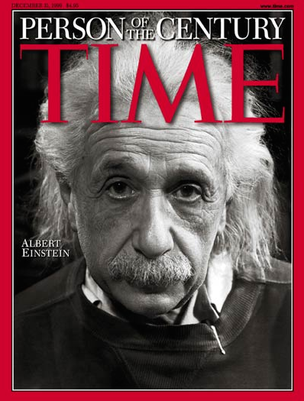
Gravity Probe B
Final Experimental Results … as of May 2011
Both effects
of General Relativity
validated
Notes:
So what were the final results? Here’s a snapshot.
Essentially, all four of the gyroscopes were in very good agreement. See the chart…
The West-East represents ‘Frame-Dragging’ and the North-South represents ‘Geodetic’
You can see the General Relativity prediction here…
… and the combined results from GP-B’s 4 gyros.
So, I would say that we validated Einstein’s General Relativity and he remain a “Master of the Universe” for a few more years.

Slide 22
Thanks for inviting me
ご清聴 有難うございました。
---
Questions
Notes:
“a-ri-ga-to-u” “go-za-i-ma-shi-ta” Thanks for listening.
Again … ‘one thing leads to another’…
The reason I’m hear today is back about 15 years ago there was a lonely young man looking for a place to live when he was a PostDoc at LL Lab.
He ran into my mother-in-law who found him a place. When he moved in she asked about funiture …dishes …food.
After a while he started living at their house … and he became their adopted son.
So, I see Yusuke as my brother-in-law.

