Slide 1

The Role of Cerebral Revascularization Surgery in the Modern Era
1st Pyongyang International Neurosurgery Symposium, DPRK
21-22 October, 2015
Marco Lee MD PhD FRCS
Associate Professor
Dept. of Neurosurgery
Stanford University
California, USA

Slide 2


Slide 3
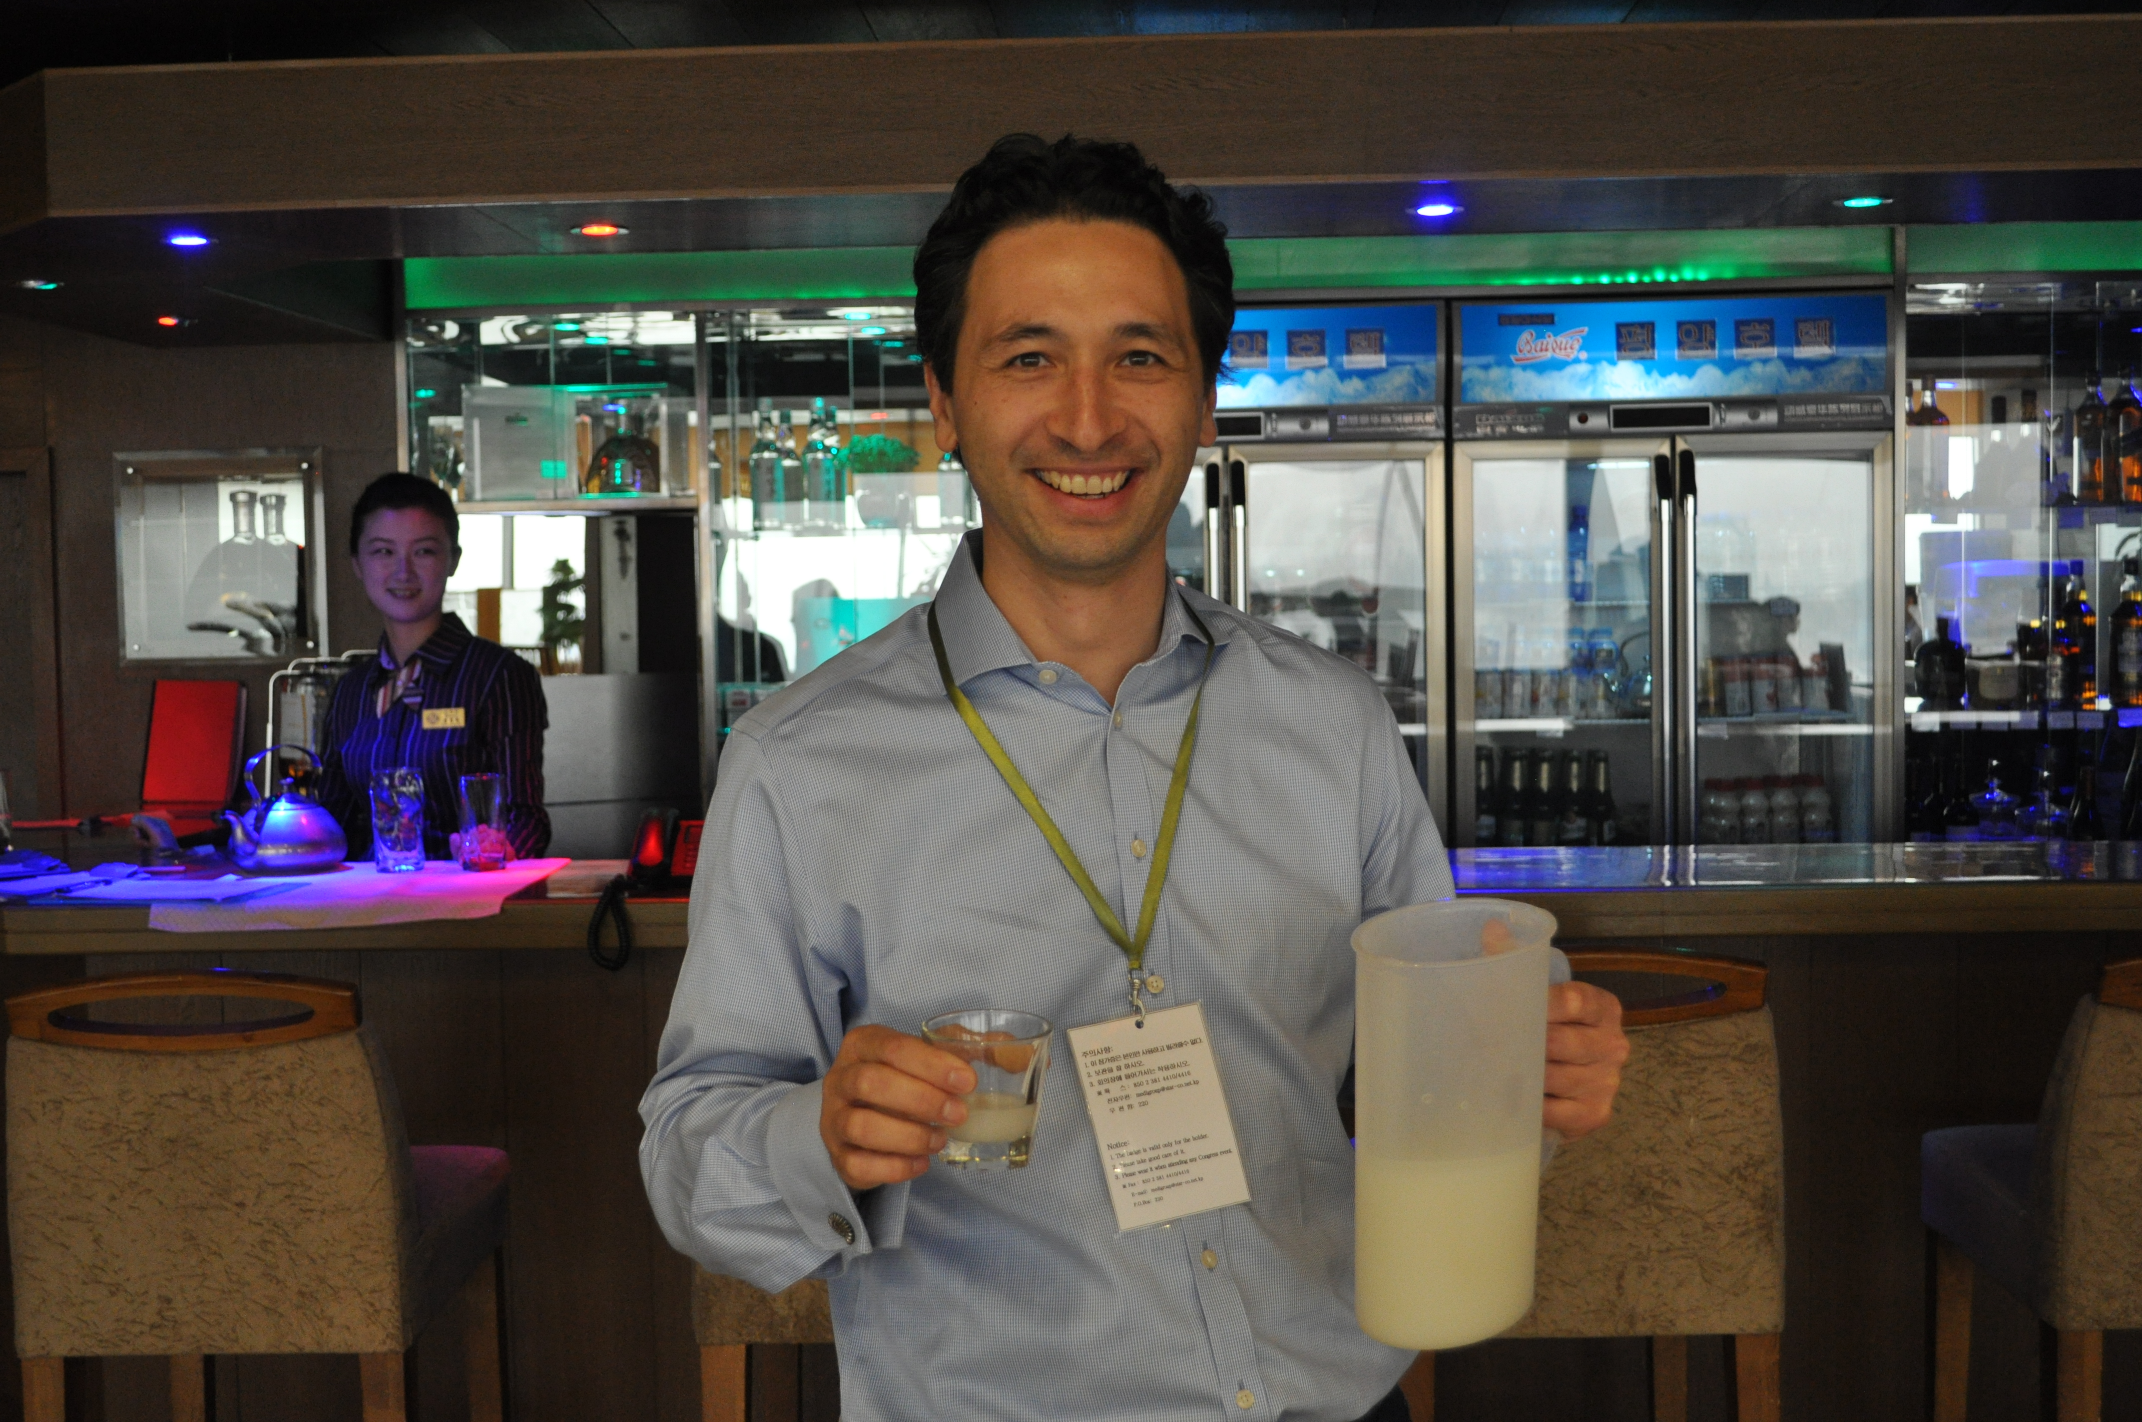
막걸리
Marco Lee

Slide 4
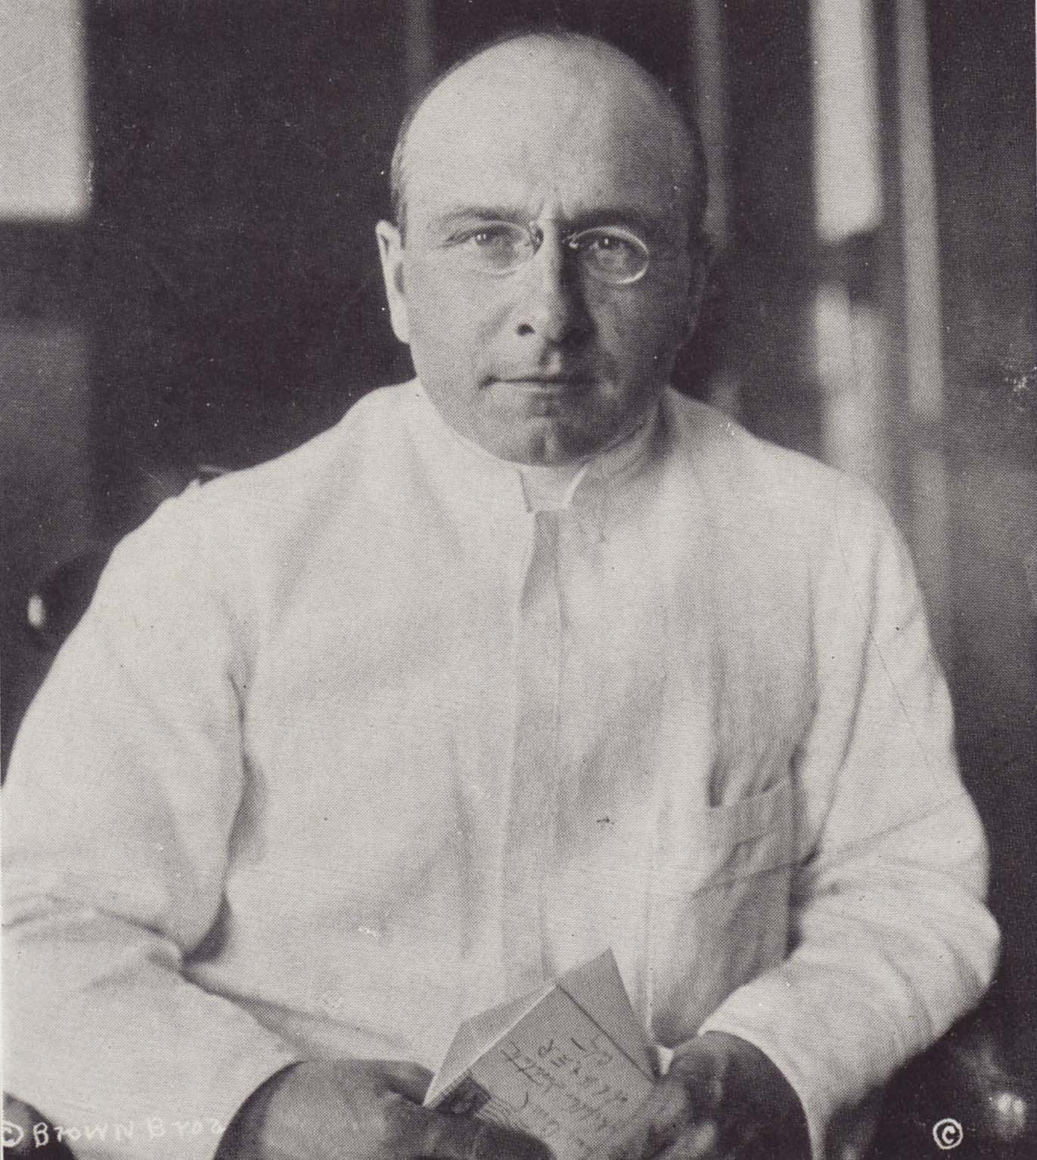
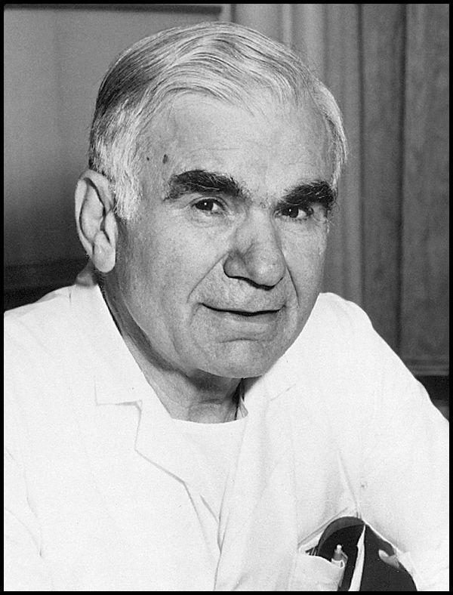
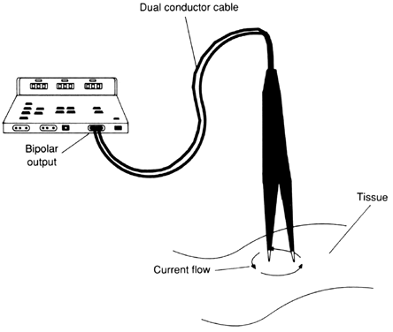
History of Cerebral Revascularization Surgery
(extremely brief!)
Alexis Carrel 1912
Gazi Yarsagil 1965
German and Taffel 1939
Jacobson and Donaghy 1962
Kredel 1942
Kurze 1957

Slide 5
Types of Revascularization Surgeries
Direct graft
  Superficial Temporal Artery (STA)
  Occipital Artery
  Radial Artery
  Saphenous Vein
Indirect graft
  Encephalo-duro-arterio-synangiosis (EDAS)
  Encephalo-myo-synangiosis (EMS)
  Encephalo-duro-arterio-myo-synangiosis (EDAMS)
  Omental transposition
  Burr holes

Slide 6
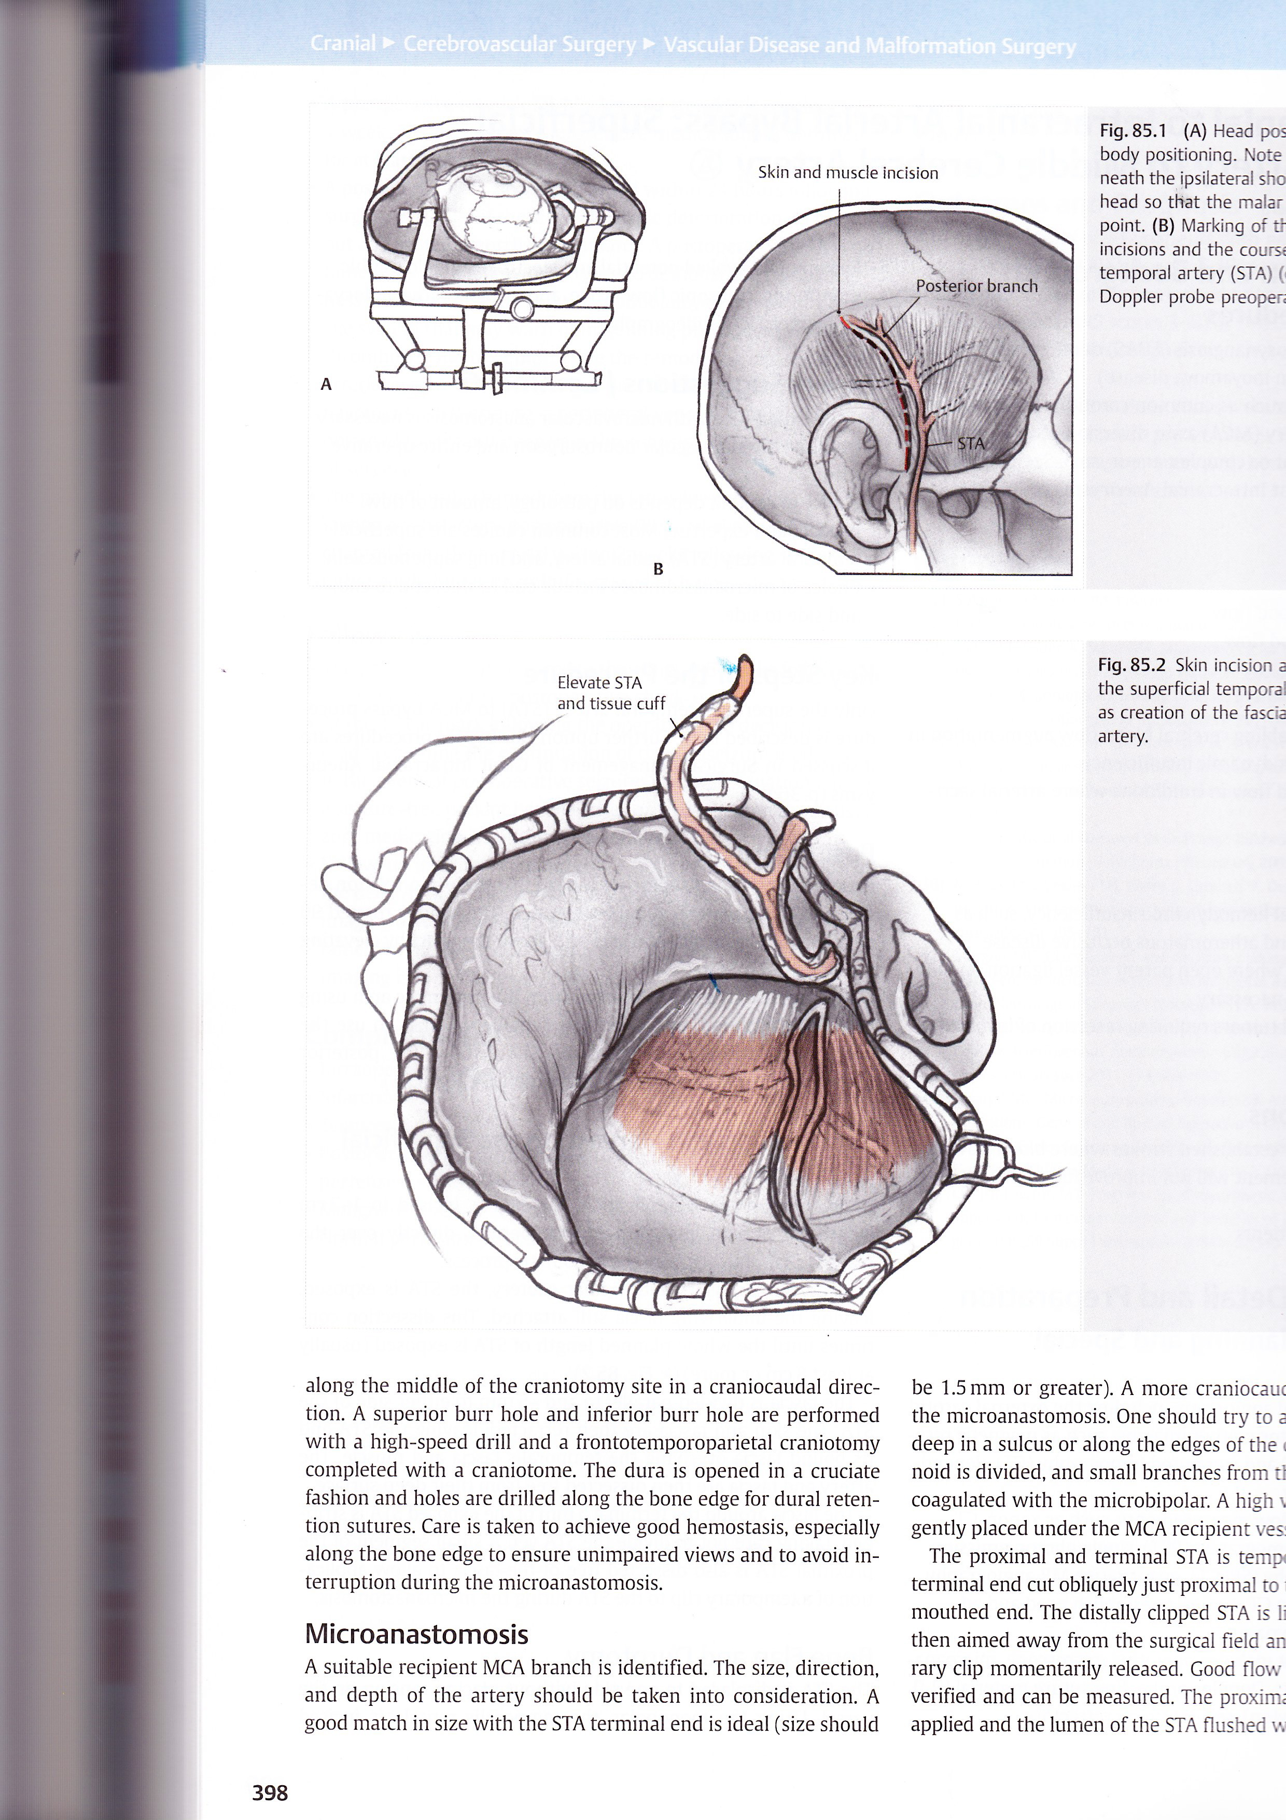
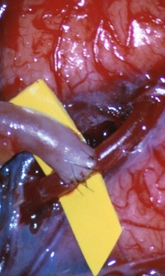
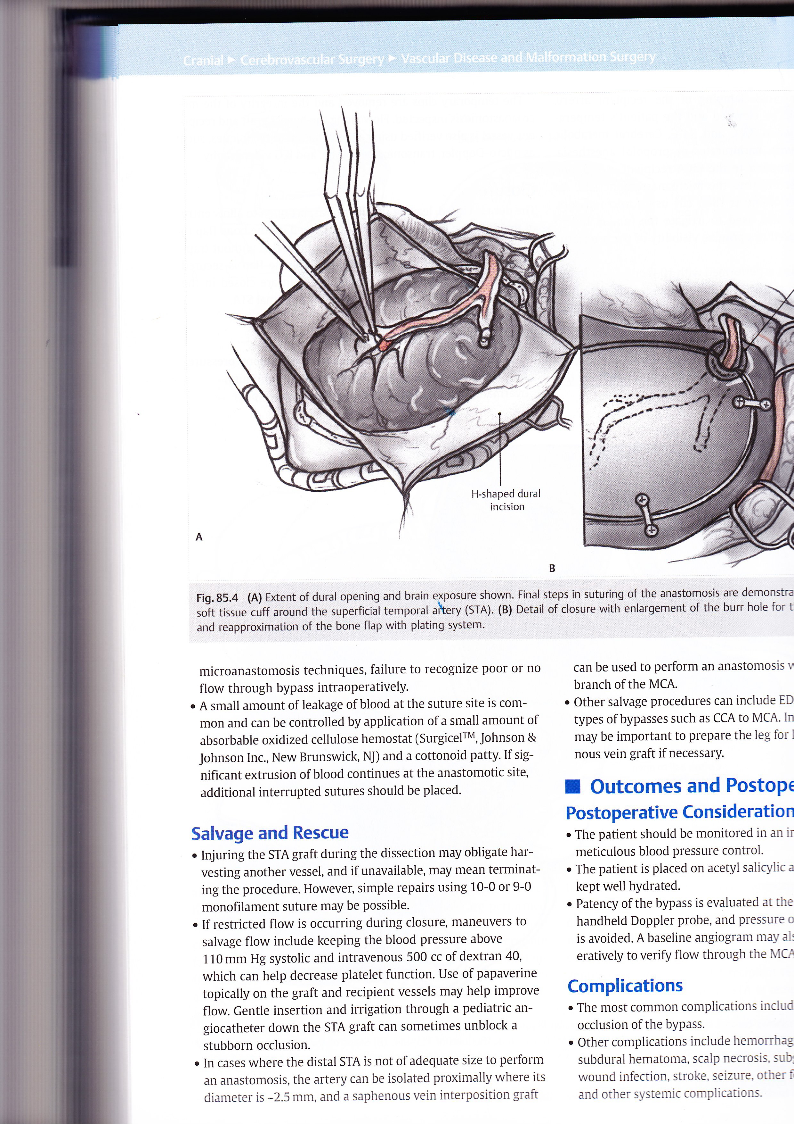
Direct STA-MCA microanastomosis
Lee & Steinberg, ECIC bypass
Neurosurgery Tricks, Thieme 2014

Slide 7
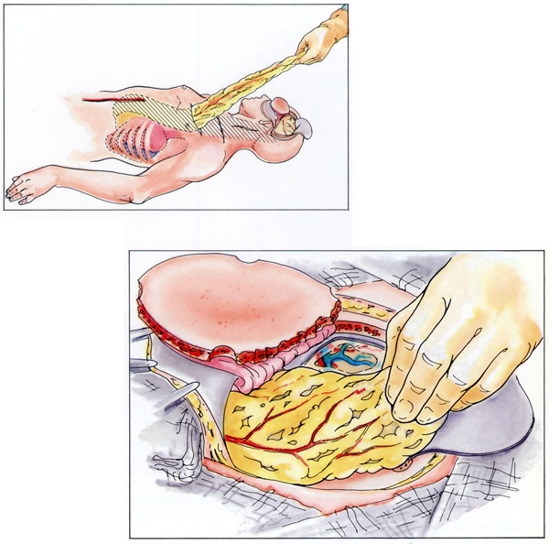
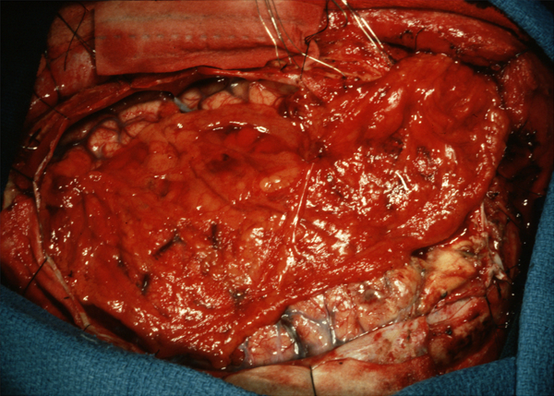
Indirect: Omental Transposition

Slide 8
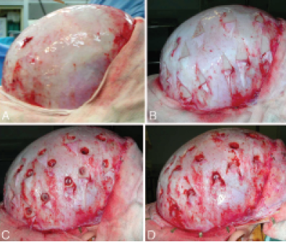
Multiple Burr hole surgery
Sainte-Rose et al. (2006). J Neurosurg 105(6 Suppl): 437-43.

Slide 9
Previous Indications
Occlusive Vascular Disease
Complex Aneurysms
  Trapping
  Vessel reconstruction
  Re-implantation
Complex skull base tumors
Moyamoya disease

Slide 10
Occlusive disease
Complete ICA occlusion. Continued Stroke and TIA
Patient selection-changes through the decades
Radiological imaging-new understanding
  Xenon CT
  CT perfusion
  PET
  SPECT

Slide 11
Studies on benefits of revascularization surgery
International study of ECIC anastomosis(1985)
St. Louis Carotid Occlusion trial (1998)
Japanese ECIC Bypass Trial: JET (2006)
Carotid Occlusion Surgical Study: COSS (2011)
Sapporo Study:Kuroda et al (2013)

Slide 12
Studies on benefits of revascularization surgery
International study of ECIC anastomosis(1985)
St. Louis Carotid Occlusion trial (1998)
Japanese ECIC Bypass Trial: JET (2006)
Carotid Occlusion Surgical Study: COSS (2011)
Sapporo Study:Kuroda et al (2013)

Slide 13
Carotid Occlusion Surgery Study
Hemodynamic failure defined with Increased OEF
Primary end point: Ischemic stroke at 2 years
  Surgery 21% vs. Medical 22.7% (p = 0.78)

Slide 14
Sapporo Double ECIC bypass study
Hemodynamic failure defined with Increased OEF and ⬇ CBF and CVR (Type 3 ischemia)
36 patients, Non-randomized (25 Surgery, 11 medical)
Primary end point: Ischemic stroke at 1 year
  Surgery 0.7% vs. Medical 6.5% (p = 0.0188)

Slide 15
Surgical Treatment of Complex Aneurysm
Clip reconstruction
Trapping
Combiner endovascular treatment
Bypass surgery

Slide 16
62 yo female SAH from recurrent left supraclinoid ICA aneurysm

Slide 17
STA-MCA bypass graft

Slide 18
Trapping of left ICA aneurysm

Slide 19
Advances in endovascular treatments
Flow diversion with Pipeline

Slide 20
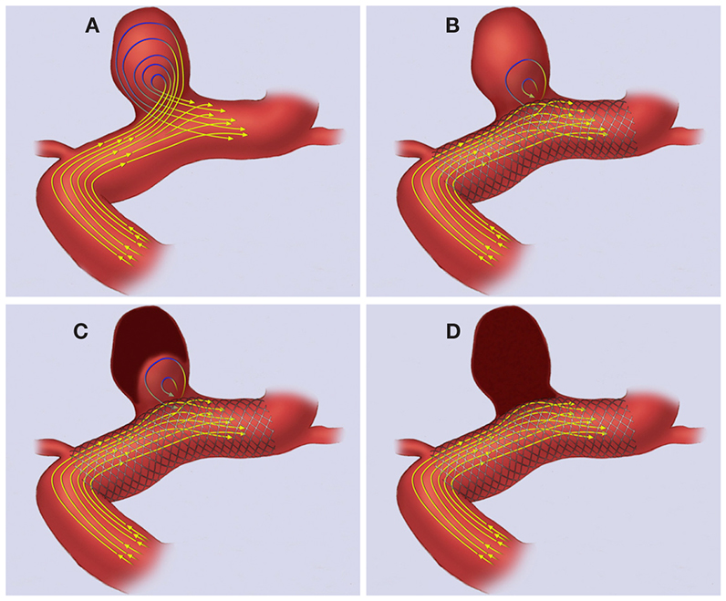
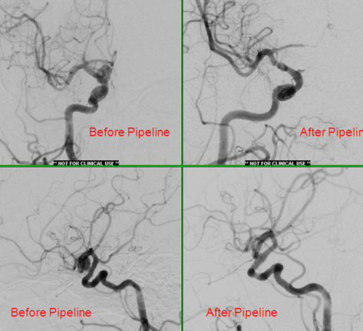
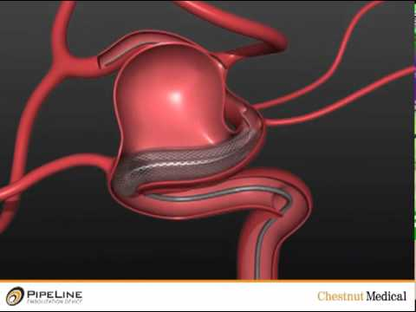

Slide 21
Moyamoya disease

Slide 22
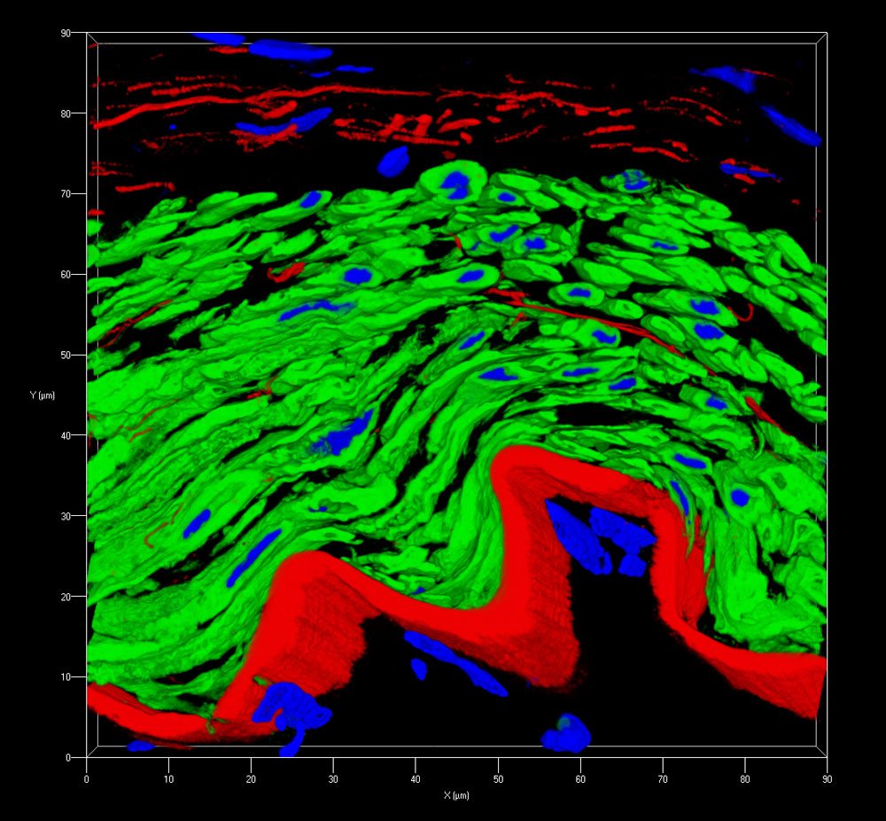
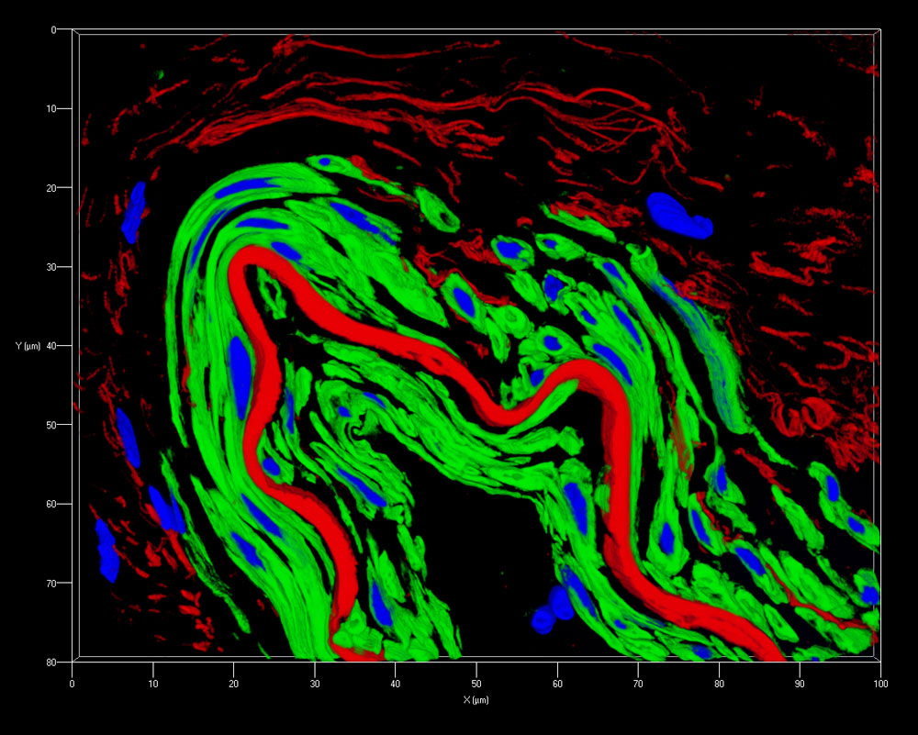
Array Tomography Reveals Aberrant Vascular Architecture (Middle Cerebral Artery, M4)
Control
Moyamoya
Lumen
Lumen
Intimal thickening
Proliferation and hyperplasia of smooth
muscle cells (media & intima)
Disrupted internal elastic lamina
Smooth Muscle Actin (green)
Elastin (red)
Nuclei (blue)

Slide 23
Moyamoya Disease
Initially identified in Japan, 1950’s
Felt to be a disease affecting Asian population
Prevalence: 6-10/100,000 (Asia)
Incidence: 0.54/100,000/yr (Asia, 2003)
0.94/100,000/yr (Asia, 2006)
0.086/100,000/yr (US, 2005)
0.57/100,000/yr (US, 2012)
Bimodal onset:
1st decade, 3rd-4th decades

Slide 24
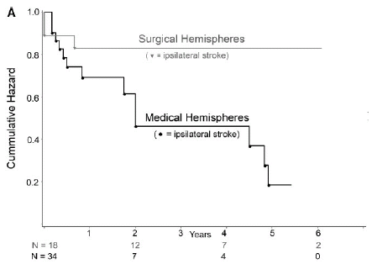
Natural History
Hallemeier et al. (2006)
5-year risk of recurrent ipsilateral stroke of
65% after the initial symptom
(17% after revascularization)

Slide 25
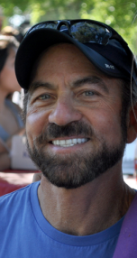
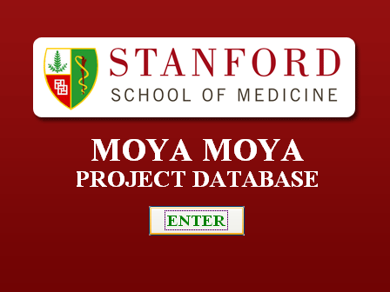
Stanford Moyamoya Center
Professor and Chairman of the Department of Neurosurgery and the Neurosciences
Co-Director, Stanford Stroke Center
Stanford University School of Medicine, Stanford, USA

Slide 26
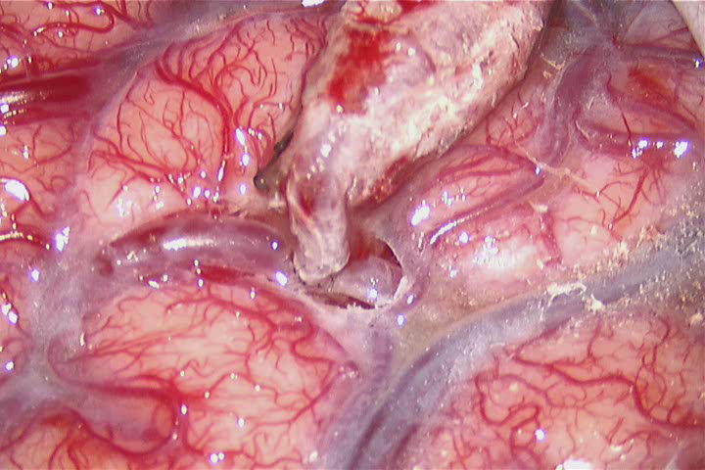

Slide 27


Slide 28
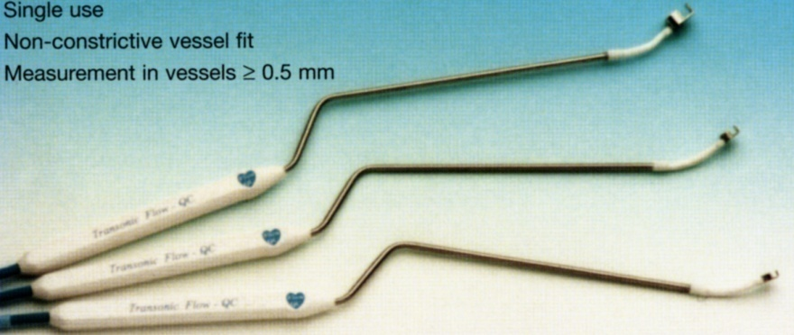
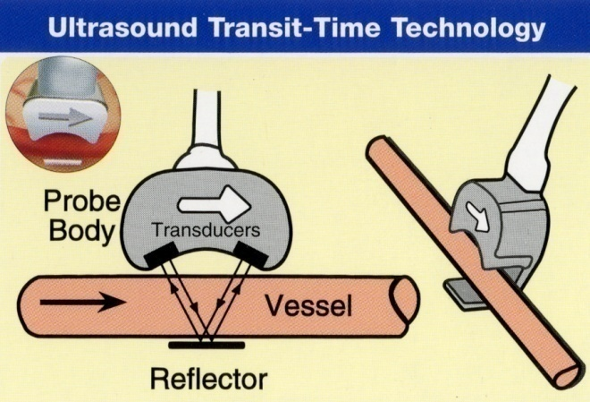
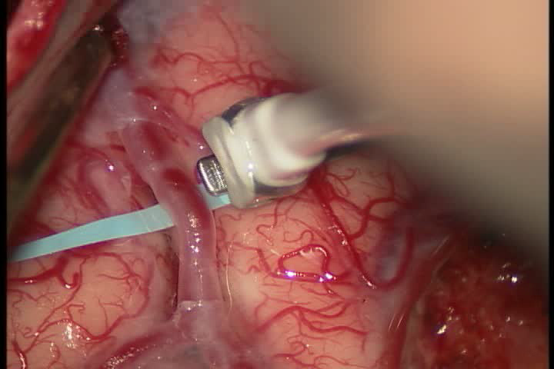
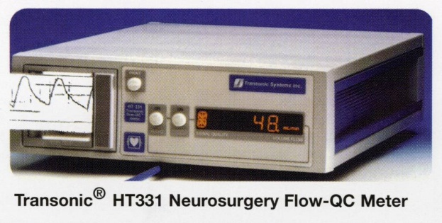
Quantitative CBF Measurement:
Transonic Flowmeter

Slide 29
Pre-anastomosis flow measurements
M4 Branch
(Proximal)
Frontal
Lobe
M4 branch
(Distal)

Slide 30
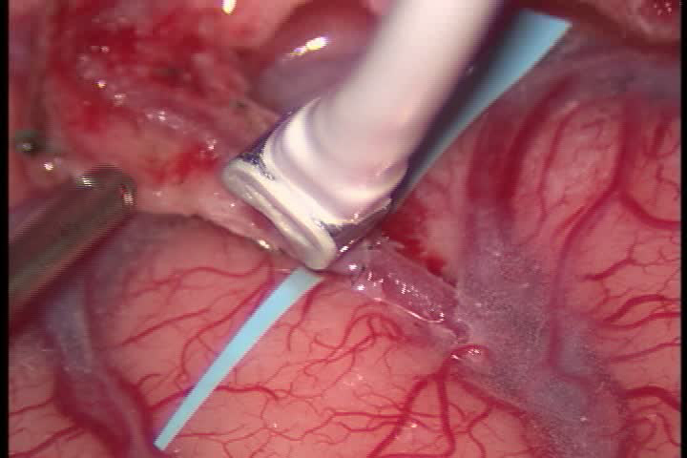
Post-anastomosis flow measurements
Proximal M4 (hidden)
STA donor
Distal M4

Slide 31
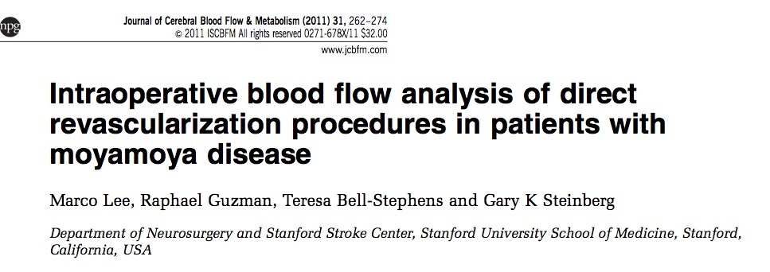
Stanford Moyamoya Series
J Cereb. Blood Flow & Metab (2011)31:262
317 patients
540 revascularization procedures
1-68 yo, mean age at surgery: 29 yo
18% presented with unilateral moyamoya

Slide 32
4.7 ml/min
4.0 ml/min
Proximal
MCA
Original flow
MCA
Distal
Positive flow
Negative flow
21.2 ml/min
STA
9.7 ml/min
13.4 ml/min
Proximal
’’’’’
Distal
MCA

Slide 33
64.2%
34.8%
Original direction
Positive flow
Negative flow
11.9%
17.8%
’’’
Same direction
’’’
Proximal
Distal
86.4%
77.4%
’’’
Bi-direction
’’’
1.7%
4.8%
’’’
Opposite direction
’’’

Slide 34
Pre and post-op Xenon-CT
Pre-op
Post-op
ml/100g/min
39.9
37.7
Pre-Diamox
43.1
41.4
44.4
40.4
9.0%
27.9%(+/- 5.6)*
Post-Diamox
6.3%
28.9%(+/-7.3)*
20.4%
38.8%(+/-4.9)*
*p=0.0027

Slide 35
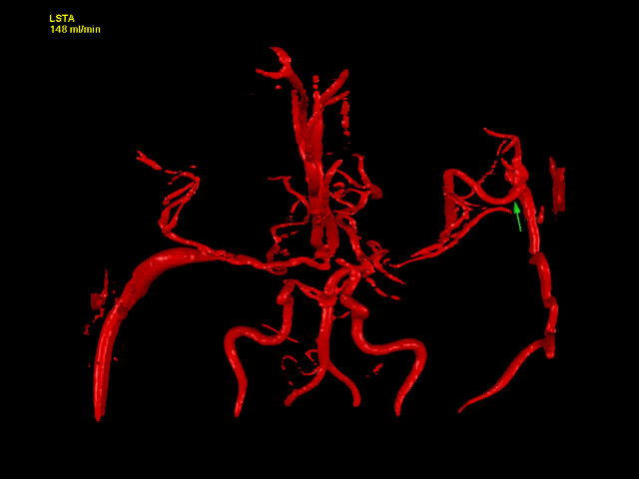
Quantitative MRA

Slide 36
Clinical Outcome
(modified Rankin Score)
P<0.0001
0: no symptoms
1: symptoms, no disability
2: slight disability
3: moderate disability
4: mod-severe disability
5: severe disability
6: dead
90% of the patients had a mRS 0-2 (mean follow-up: 4.1 years)

Slide 37
Post-operative complications:
Post-op stroke

Slide 38
Post-op hemorrhage

Slide 39
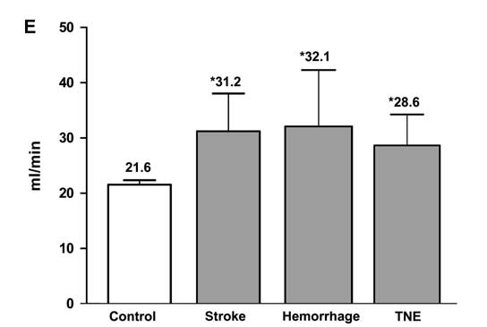
Higher Total MCA flows correlate with post-op complications
Complications: ischemic stroke, hemorrhage,
transient neurologic events (TNE)
Lee, et al: JCBFM 31:262-74, 2011

Slide 40
Conclusions
3 main indications for cerebral revasculaization
  Moyamoya disease
  Complex aneurysm
  Occlusive vascular disease

Slide 41
Conclusions
Changing indications due to
  Advances in endovascular technology
  Advances in medical therapy
  Advances in radiation therapy

Slide 42
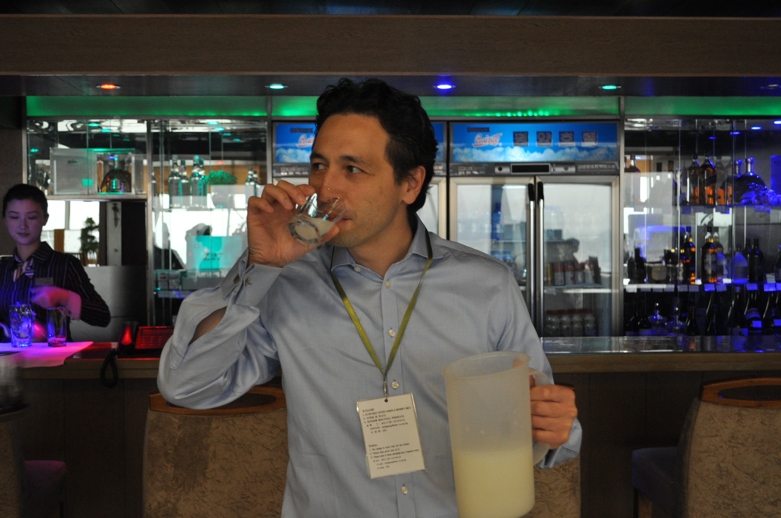
감사합니다

