Slide 1

Stereotactic Radiosurgery Treatment of Intracranial tumors
1st Pyongyang International Neurosurgery Symposium, DPRK
21-22 October, 2015
Marco Lee MD PhD FRCS
Associate Professor
Dept. of Neurosurgery
Stanford University
California, USA

Slide 2
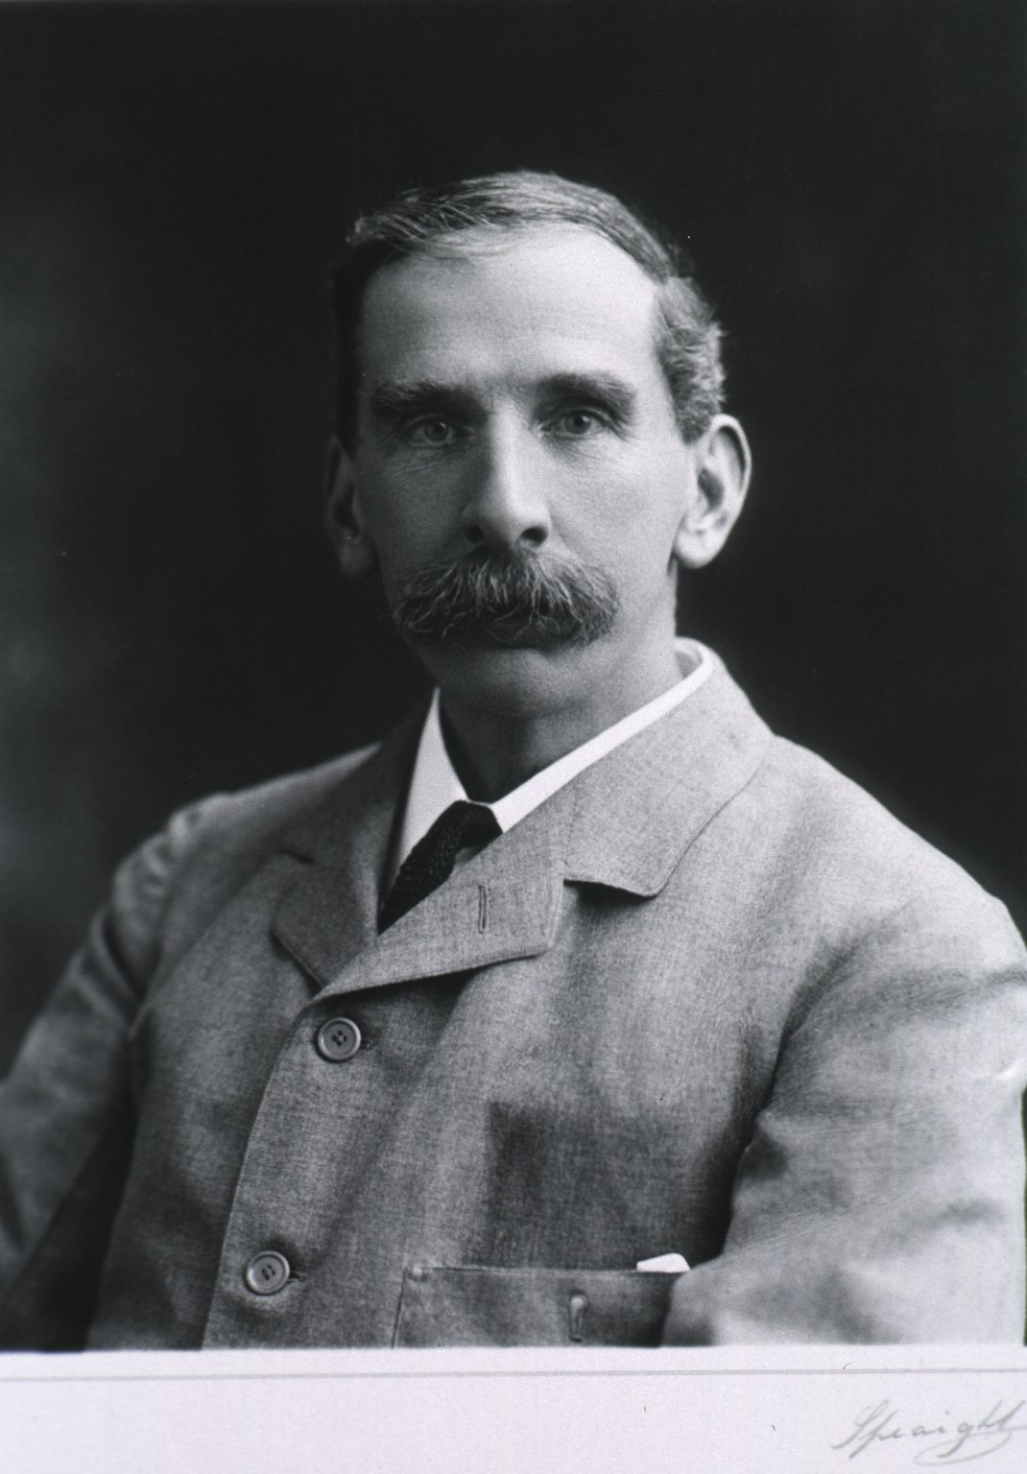
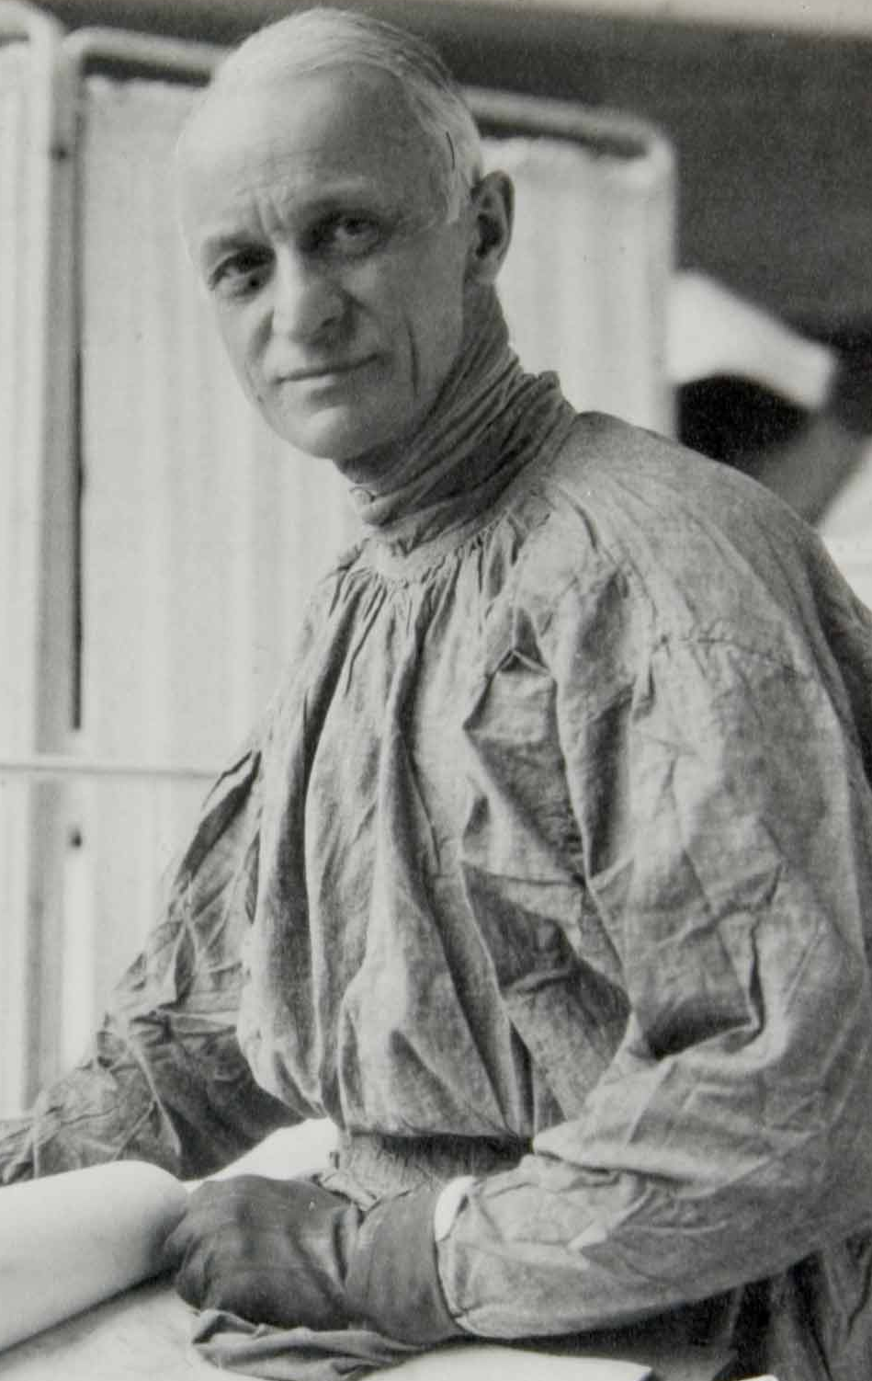
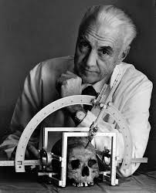
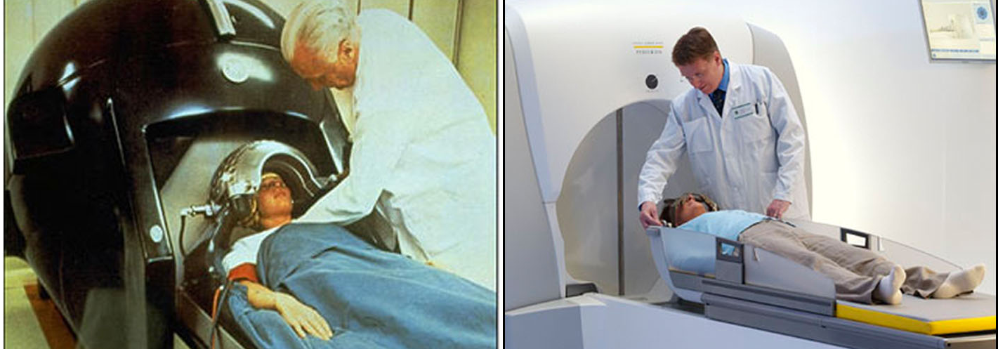
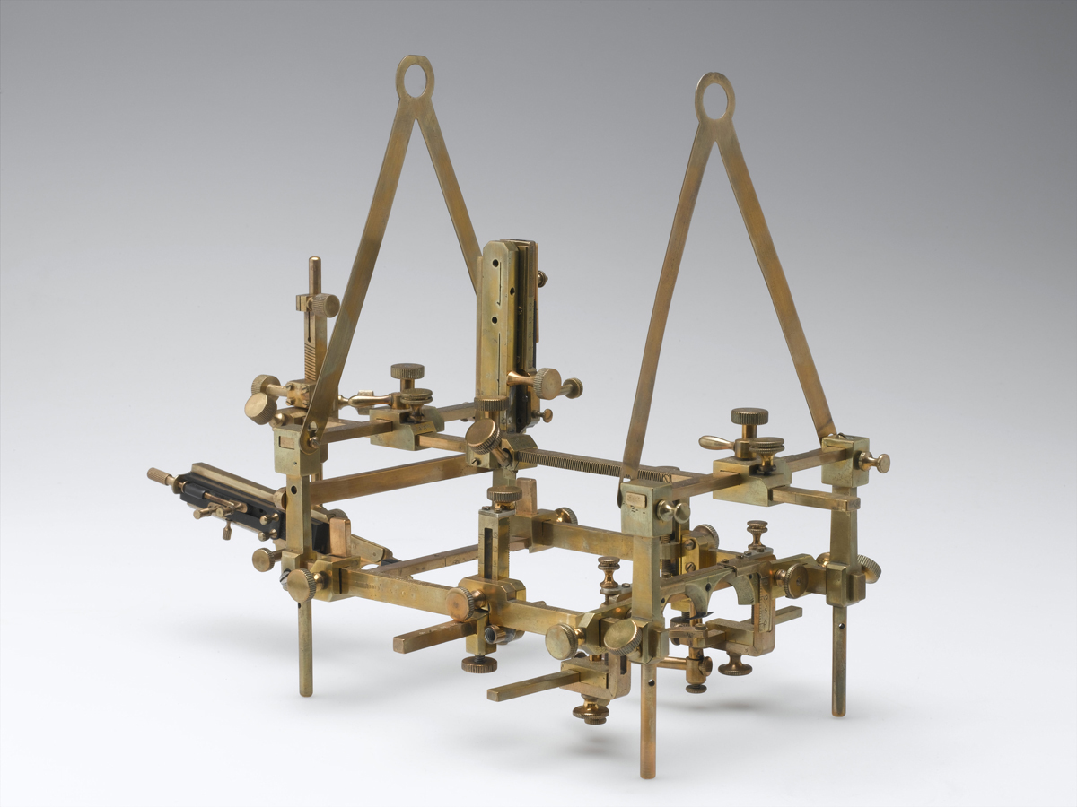
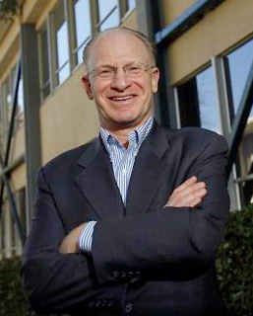
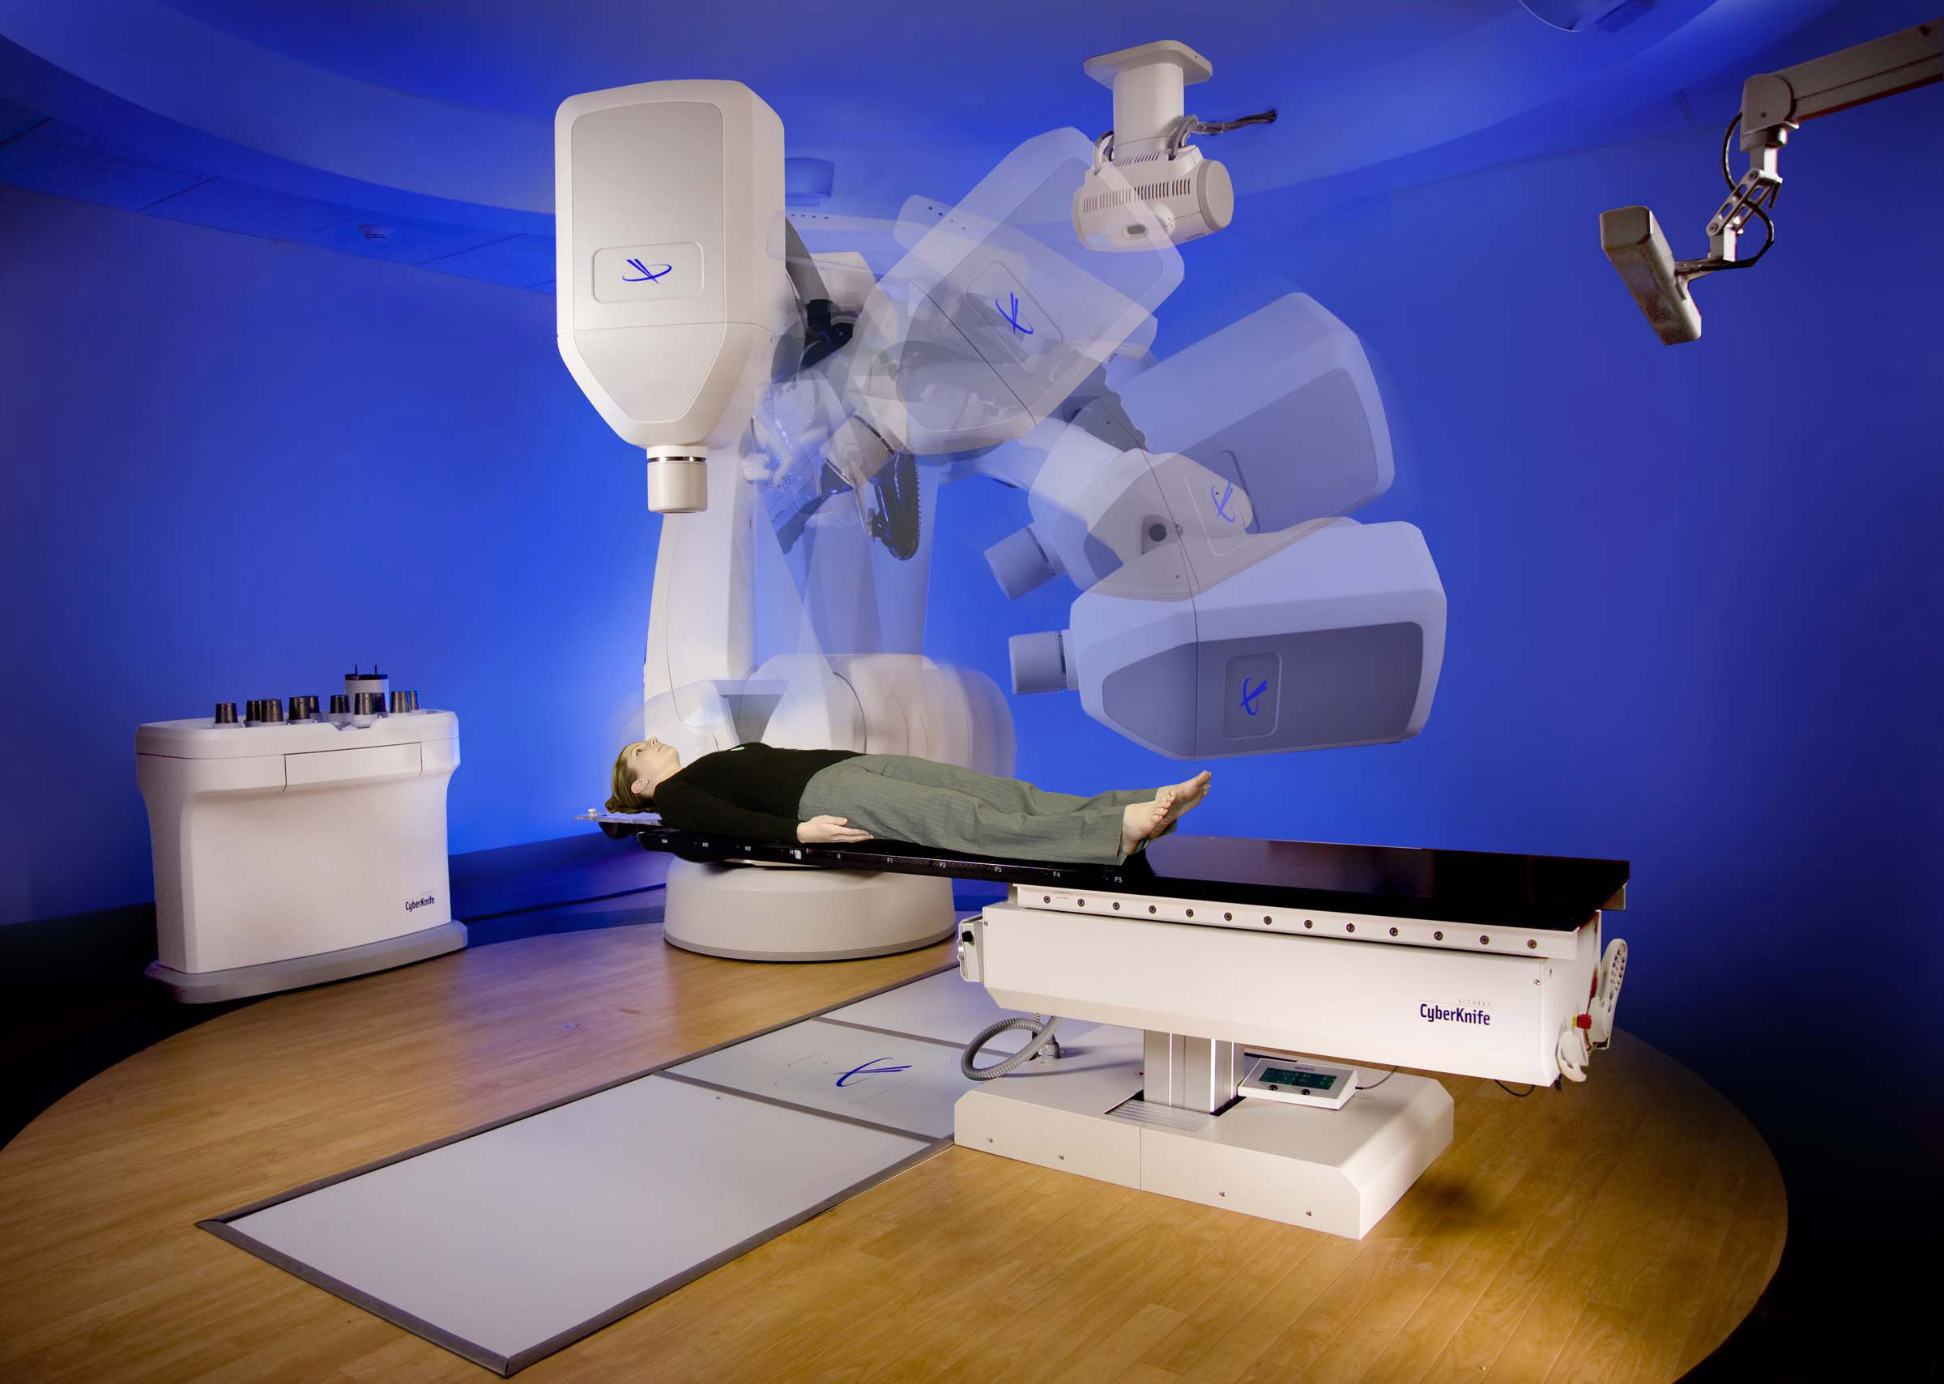
History of SRS (very briefly, on one slide!)
Harvey Cushing
Radium Needles
1920
Lars Leksell
GammaKnife
Frame-based SRS
￼
1967
2015
Victor Horsley
Horsley-Clark Apparatus
1908
John Adler CyberKnife Frameless SRS 1994

Slide 3
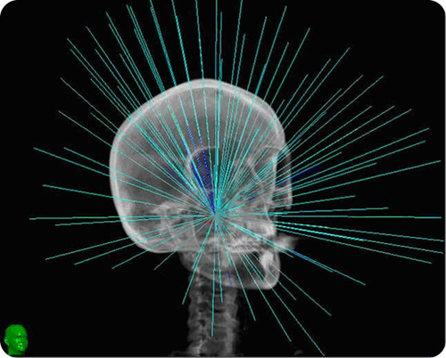
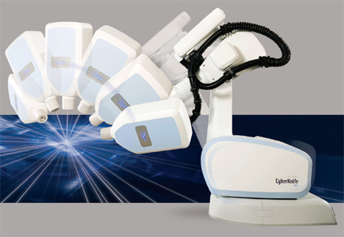
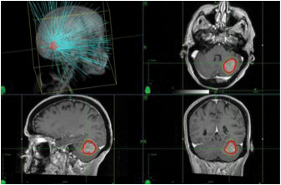
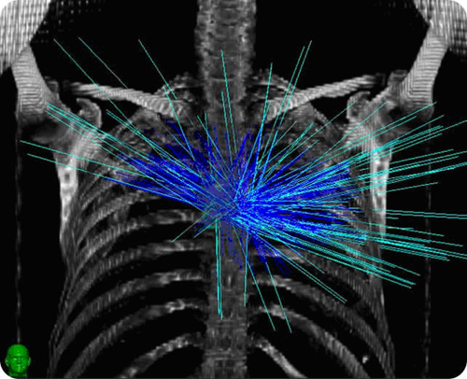
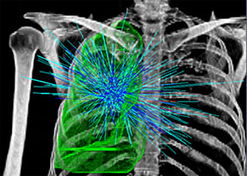
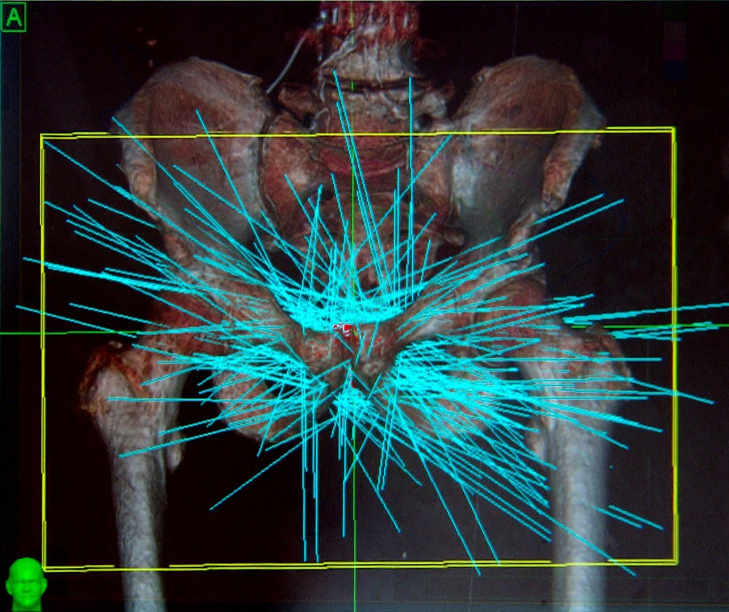
SRS= Single session
Fractionated SRS= up to 5 sessions
Extra-cranial locations
Spine
Lung
Prostate

Slide 4
SRS and Tumors
Benign tumors
  Pituitary Adenomas (Non-functional and functional)
  Vestibular Schwannomas
  Meningiomas
Malignant tumors
  Atypical and Anaplastic type
  Metastases

Slide 5
59 yo Left mild hearing loss and dizziness. Growth seen over 2 years.
2 years

Slide 6
SRS for Vestibular Schwannoma
Typically only if <3cm
Typically margin dose 12-14 Gy
>90% control rates at 10 years follow up
50-70% hearing preservation
>99% facial nerve preservation
Growing evidence SRS has better tumor control, hearing and facial preservation than surgery in <3cm

Slide 7
42 yo male. Progressive ataxia, weakness, dysphagia. Decreased but functional hearing.

Slide 8
Post-op grade 3 hearing loss, grade 3 facial weakness. Improved to grade 2 hearing loss and normal facial function at 3 months
Diagnosis: Vestibular Schwannoma

Slide 9
SRS to residual tumor
6 months post-op

Slide 10
3 yrs post-SRS

Slide 11
Large (>3cm) Vestibular Schwannomas
Gross total vs. Subtotal Resection
 | Gross Total Resection (Radical extracapsular) | Subtotal resection (Intracapsular decompression)
Mean Follow up | 53 months | 58 months
Mean tumor vol. | 0.9 cc | 5.1 cc
GR Class I or II | 0% | 100% | P<0.001
HB Grade I or II | 35% | 89% | P<0.01
Pan et al, 2012

Slide 12
36 yo male with visual problems.
Pre-op
Post-op

Slide 13
5 years post-op MRI follow up.
Patient is asymptomatic.

Slide 14
3 years post-SRS. Patient remains asymptomatic

Slide 15
SRS for Pituitary Adenomas
Typically margin dose 12-20 Gy
83-100% control rates at mean 46 mo follow up
0-39% SRS-induced hypopituitarism (Median 8%)
<7% new optic neuropathy
Functional tumors require higher doses and risks of complications are higher.
Maximal safe surgical resection still the goal.

Slide 16
45 yo facial pain and numbeness.
Trial of conservative treatment and follow up MRI scan for 6 months.

Slide 17
CT and MRI merge

Slide 18
Role of the neurosurgeon, radiation oncologist and medical physicist in SRS

Slide 19
5 yrs post-SRS
Pre-SRS
Post--SRS

Slide 20
SRS for meningiomas
Dose varies widely depending on size and location
>80% control rates for WHO I at 10 years follow up
10% neurological deterioration in skull base meningiomas at 10 years.
Peritumoral edema higher incidence in convexity, parasagittal and parafalcine vs. skull base meningiomas
Growing evidence for subtotal resection of large skull base meningiomas near critical neurovascular structures vs. gross total resection

Slide 21
Timing of SRS: Upfront vs. Waiting for recurrence
Atypical and Anaplastic Meningioma

Slide 22
Solitary Brain Metastasis
Pre SRS
2 yrs Post SRS
Single Fraction

Slide 23
Brain metastases
Most common indication for SRS
WBRT vs. SRS-no significant difference in overall survival, OS (1-3 mets)
WBRT + SRS longer survical vs. WBRT (6.5 mo vs. 4.9 mo, p=0.039). 43% higher local recurrence and worse performance (KPS) in WBRT alone
SRS vs. WBRT + SRS-no significant differecse in OS
Less cognitive decline, better functional outcome and quality of life in SRS alone group. WBRT ecreased local and distant metastastases ecurrence, but not OS.
SRS alone: Treatment of choice

Slide 24
SRS treatment to resection cavity.
SRS treatment to more than 5 metastases.
Resection cavity
Multiple metastases (>5)
This case” 43 mets planned

Slide 25
Chondrosarcoma
Pre-op
Post-op

Slide 26
Spine tumor

Slide 27
Cerebral AVM

Slide 28
Spinal Cord AVM
Pre SRS
Post SRS

Slide 29
Trigeminal neuralgia

Slide 30
Other SRS complications
SRS induced neoplasia: Very rare (1 in 1000- 1in 2000 or 0.04% risk over 15 years)
  Malignant gliomas, malignant peripheral nerve sheath tumors, sarcomas and meningioma
Radiation necrosis: Is it recurrence?

Slide 31
Conclusions
Cranial, extra-cranial and non-neurosurgical sites
Preferred treatment for some small tumors
Subtotal resection near neurovascular critical areas with SRS used to treat residual or recurrence
Preferred treatment for most metastases
Evolving role in other neurosurgical conditions: Functional and Psychiatric.

Slide 32
Questions
How are you treating the vestibular schwannomas?
How are you treating solitary metastases?
What is your management of tumors with extension to neurovascular structures, eg. Cavernous sinus?

Slide 33

감사합니다

