Slide 1

Stanford Profiles
Gear Up for Research
April 6, 2015

Slide 2
Stanford Profiles History
Prior to 2012, CAP (Community Academic Profiles) was created by the School of Medicine for the School of Medicine. The site has been in existence since 2004.
In 2012, the CAP University-Wide Expansion Project began to expand CAP profiles to faculty, staff, postdocs and graduate students in selected schools, institutes and administrative units across Stanford. The project continues today to onboard further organizations with the end goal of having all schools and organizations represented in CAP. The project executive sponsor is Ann Arvin, Vice Provost and Dean of Research.
2004
CAP created for and by SoM
September 2012 University-Wide Expansion Project Kicked Off
August 2013 CAP Live with New Pilot Organizations
January 2014 New Stanford Profiles Public Site Launched
June 2014 Start of School of Humanities & Sciences Engagement
November 2014
Kick-Off of Faculty Engagement
January 2015 Hosting of Stanford Profiles transitioned to Administrative Systems
February 2015 Kick-Off of Re-engagement with Pilot Organizations

Slide 3
Initial Project Objective:
Expand CAP profiles to faculty, staff, postdocs and graduate students in selected schools, institutes and administrative units across Stanford
Features
New SU branding and interface
Collaboration tools
Auto-population of names, titles, appointments, courses taught, postdoc advisee names, and publication citations
Links to CV, Biosketch, websites, social networking, etc.
Publication citations from Web of Science cover more than 15,000 journals.
Profile controls which downloaded publications appear and which publications are highlighted
Web services APIs allow schools and other University web sites to access CAP data and publish under their local branding and formats.

Slide 4
Source Systems
PeopleSoft
    FAAS, Faculty Events, HR
    Names, affiliations
    Education history
    Courses Taught
    Advisers and advisees
StanfordYou, Axess
    Contact information
Stanford Library
  Web Of Science
  PubMed
ClinicalTrials.gov
Stanford Hospital MSO
Salesforce Chatter
And more…

Slide 5
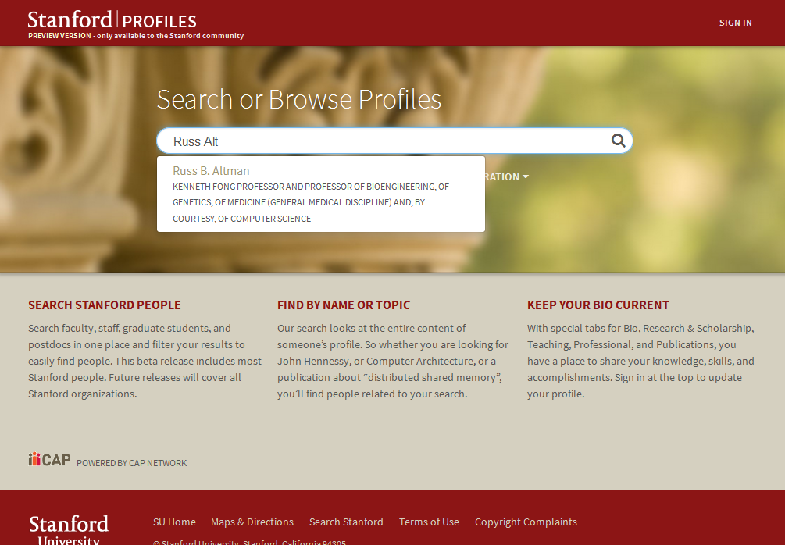
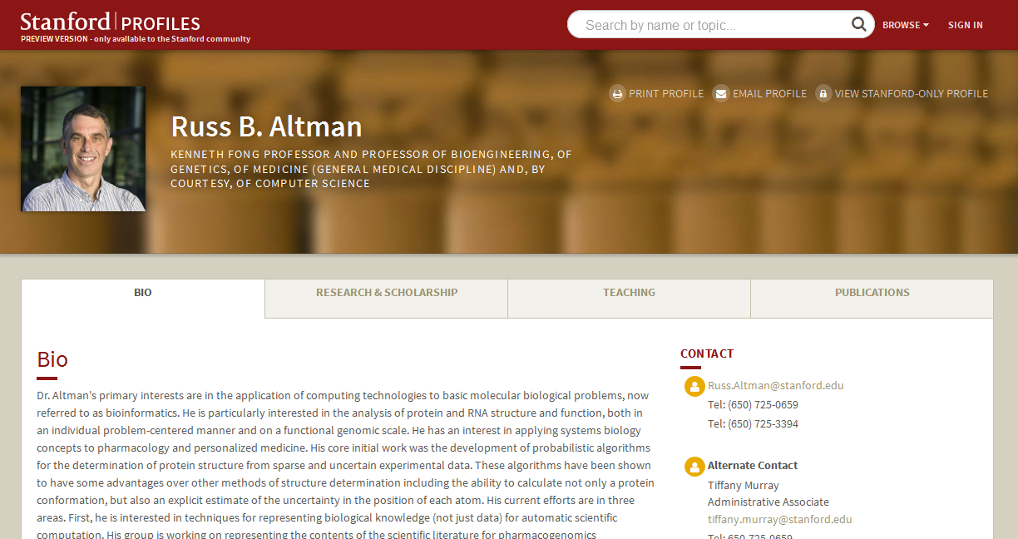
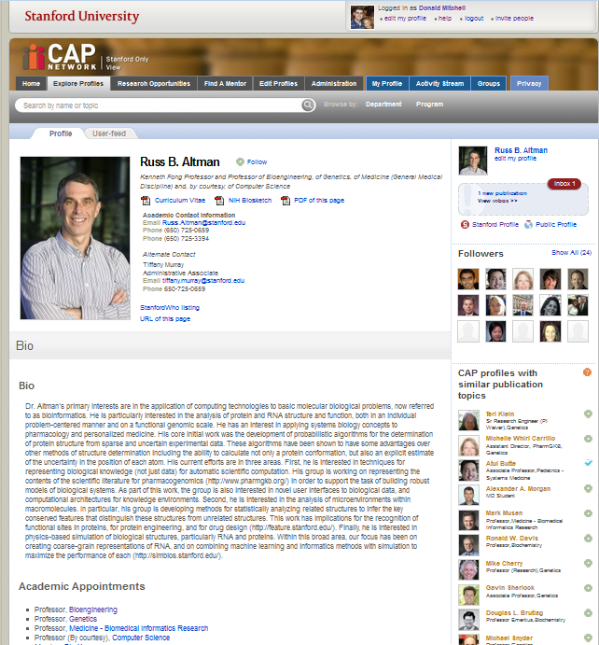
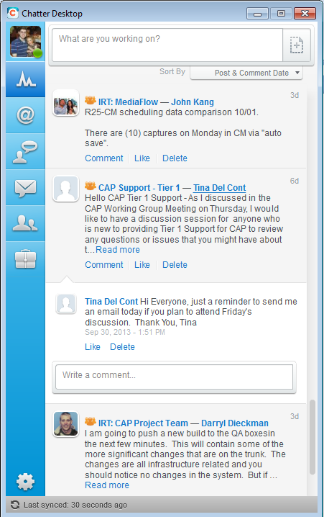
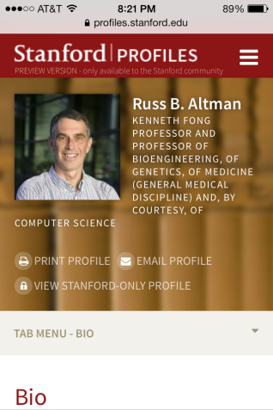
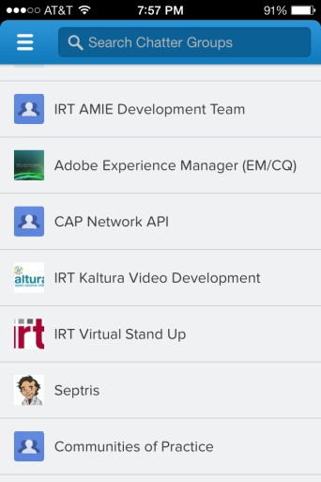
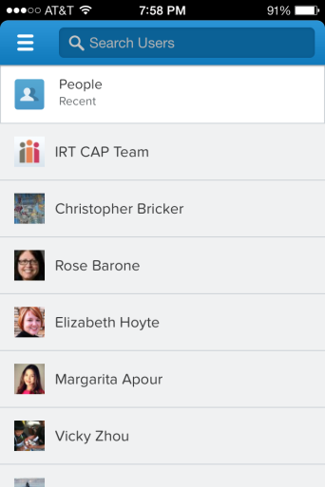
Stanford Profiles (aka CAP)
On the web…
On desktops and mobile devices…

Slide 6
Value to Stanford
Makes the work and achievements of faculty readily accessible to prospective students and postdoctoral fellows and potential funders of research including industry, foundations and donors
Facilitates communication for the onboarding and orientation of new graduate students
Distinguishes Stanford from other peer institutions investing in similar systems
Increases research collaborations within and across disciplines at Stanford, and externally
Enables Faculty, Postdocs, Students and Staff to update information directly and for purposes of sharing current C.V.s, preparing annual reports and other tasks
Improves reporting of research and education activities for individuals with enhanced data integrity

Slide 7
Stanford Profiles and Research
Your Profile
  If you are faculty, postdoc, student or staff, you can add the following information on your profile to show your current focus and to collaborate with colleagues:
    Bio
    Projects and / or Research Projects
Faculty, Postdocs and Students can also add:
    Current Research and Scholarly Interests
    Research Opportunities (SOM Faculty and Students, All Postdocs)
    Community and International Work (SoM Faculty, All Postdocs)

Slide 8
Stanford Profiles and Research
Postdocs and Students can also add:
    Lab Affiliations
All Profile Owners can add:
    Keywords
      Add keywords to your profile that will help potential collaborators find you on the Stanford Profiles site.
    Publications (automatically imported and manual entry available)
      Profiles with Similar Publications (automatically generated on your profile from mesh terms)
      Publication Tag Cloud (automatically generated on your profile from mesh terms)
    Presentations

Slide 9
Stanford Profiles and Research
Find Current Research and Collaborators
    Search
      Use the Stanford Profiles Search feature and key in research topics to find others working in similar areas, on similar projects, who have written publications on the same topic.
    Search for Profiles by Name
      Find a particular person (faculty, postdoc, student or staff ) who is working in a related field, area or discipline and see their current research information, projects, publications, and collaborators.
  Follow Colleagues and Create or Join Groups with the sites Professional and Secure Social Networking feature that uses Salesforce’s Chatter
    Search or Browse to find a colleague whose work you are interested in and you can simply click the ‘+Follow’ option provided to be informed of their postings on the site.
    Create private or public (Stanford) groups and invite others to join or you can set up memberships for established groups, committees, and more.

Slide 10
Where we are now….
Over 22,000 profiles in the system
4,751 Faculty, Research and Teaching Staff
7,936 Students
2,329 Postdocs
8,581 Staff
Onboarded
School of Earth, Energy & Environmental Sciences
School of Engineering
School of Medicine
Bio-X, FSI, Precourt, Woods
Onboarding
School of Humanities & Sciences
Graduate School of Education
Graduate School of Business

Slide 11
Future Vision
Cross institution profile search and sharing
Expanded profile categories
  Funded research projects
  Case papers
  Expanded scientific publications
Visualizations of collaboration networks
Support for administrative processes
  CV Management
  Grant Preparation
  Permanent profiles

